Slide 1
Facilitator's Guide – slides 2 to 4 Last Updated: June 4, 2024

Slide 2
Truth and Reconciliation (TR) Tool Facilitator Instructions: Prepping the team for Session 1 Completing the Tool (NOT PART OF PRESENTATION)
Review the TR tool. Links are provided in the TR tool to applicable legislation and guidance. As facilitator you do not need to be an expert in the legislation and guidance; but you should ensure you have reviewed the legislation and guidance.​
Review the Indigenous Partnership Strategic Framework (IPSF), as the TR tool was developed to help teams apply the concepts within the IPSF.​
Provide the TR tool and the IPSF to your team. Ensure you communicate the importance of reviewing the tool and the legislation and guidance links, and the IPSF before your team’s workshop. Having everyone prepared will provide the most value to the session.​

Slide 3
Truth and Reconciliation Tool Facilitator Instructions: Prepping the team for Session 1 – Cont'd Completing the Tool (NOT PART OF PRESENTATION)
Schedule a workshop to complete the TR tool with your team. Ask participants to have a copy of the TR tool readily available to reference and work with during the workshop.
Identify a recorder to enter comments directly into the tool. The team will work through all sections of the tool except the summary of actions for the strategic plan, annual operating plan, and work plan at the end of the tool. Working through the tool could take 1 to 3 hours depending on the team's preparation and discussion in the session.
Schedule a second session with the team to review the results of the workshop and complete the summary of actions for strategic plan, annual operating plan, and work plan section of the TR tool.

Slide 4
Truth and Reconciliation Tool Facilitators Instruction – Session 2 Adding Actions to Annual Plans (NOT PART OF PRESENTATION) Completing the Tool (NOT PART OF PRESENTATION)
Identify the recorder for the session.
Recap the team's findings from session 1 and the connections to the legislation and guidance documents. Note any points that fit into any of existing three existing planning processes - current or future planning.
Work through the actions identified by the team and group the actions according to a) the summary of actions for strategic plan, b) annual operating plan, and c) work plan at the end of the tool. This process may take 1 to 2 hours depending on the level of preparation the team has done prior to the session, and the level of team discussion during the session. Have the recorder document the team's recommendation for each plan. Note whom within the team will take leadership for the priority actions.
Schedule a 3rd session. After session 2, send the team's decisions and internal leaders out to the team. Ask that the leader for each area draft next steps for priority areas to share at the next session,

Slide 5
Truth and Reconciliation Tool Planning Session
Add your team's name and date

Slide 6
Agenda
Introduction​s
Land Acknowledgement / Our Path to Reconciliation Video
Review and consider relevant legislation and guidance
Identify actions to include in planning (follow up session)

Slide 7
Acknowledgement of Indigenous Ancestral and Territorial Lands
We acknowledge that health services across Manitoba are provided in facilities located on the original lands of First Nations, Inuit, and on the homeland of the Red River Métis Nation. ​
​
Manitoba’s health authorities respect that First Nations treaties were made on these territories, acknowledge harms and mistakes, and we dedicate ourselves to collaborate in partnership with First Nations, Inuit, and Métis peoples in the spirit of reconciliation.
Notes:
[Update to your organization's land acknowledgement or included is Shared Health's Acknowledgement]​
​
Reflect on your personal land acknowledgement depending upon where you reside.

Slide 8
Our Path to Reconciliation Video - National Center for Truth and Reconciliation
Notes:
https://youtu.be/VPrQNe2o4FY
Watch this short video of Indigenous students, staff, and faculty at the Univeristy of Manitoba speak their truths on anti-Indigenous racism. The National Center for Truth and Reconiliation is pleased to announce the University of Manitoba has partnered with us on Call to Action 57 - truth and reconciliation public servant education - to create this video and workshop: Our Path to Reconciliation. This video is a snapshot of the full-length video that accompanies the workshop for the University community to hold an open dialogue to create a safe and respectful environment. The NCTR would like to say thank you to everyone who shared their experience to create essential change. Crowhawk Entertainment Inc.

Slide 9
Introduction and Background

Slide 10
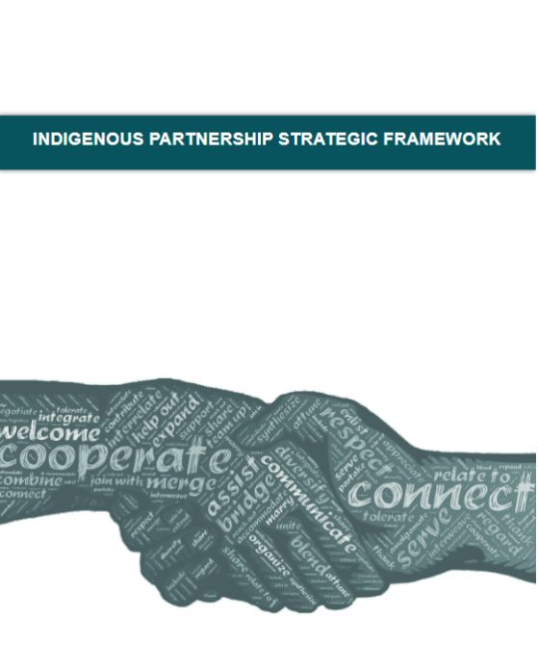
Why are we here?
The Indigenous Partnership Strategic Framework (IPSF) was developed following engagement workshops that took place in the fall of 2019.
The IPSF speaks to establishing authentic partnerships and conducting meaningful engagement with Indigenous partners.
The Indigenous Partnership Team (IPT), now Shared Health Indigenous Health was formed in 2021 to help operationalize the IPSF, with the goal to aid in transforming the current health system into one that ensures services are culturally safe and accessible for Indigenous people in Manitoba.
2019
Notes:
Speaking notes
As part of Health System Transformation underway across Manitoba, engagement workshops took place in the fall of 2019 to develop a framework for long-lasting collaboration within the health system, known as the Indigenous Partnership Strategic Framework (IPSF). Indigenous health care providers were key contributors, in addition to internal system leaders.
​The recommendations and guidance provided within the IPSF speak to establishing authentic partnerships and conducting meaningful engagement with Indigenous partners. The goal of applying the Framework is to aid in transforming the current health system into one that ensures services are culturally safe and accessible for Indigenous peoples in Manitoba.
In 2021, the Indigenous Partnership Team was formed to help operationalize the IPSF and set about developing additional guidance and tools to help teams apply the concepts within the Framework. One of these tools is the Truth and Reconciliation tool, which we will be working through today.
This tool will walk us through the provincial, federal, and international legislation and guidance that is relevant to us in the health system, and which calls for meaningful change to ensure the collective and human rights of Indigenous peoples are recognized and upheld.

Slide 11
Acknowledgements
Indigenous people who have contributed to the legislation and guidance
Contributors to the Indigenous Partnerships Strategic Framework
Service Delivery Organization teams
Health System Leadership
CPSP and Operational Teams
Indigenous Partnership Team

Slide 12
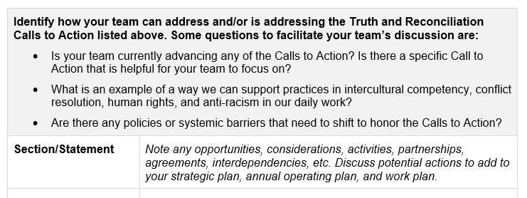
Advancing the Indigenous Partnership Strategy Framework
Why use the tool?
Action the Indigenous Partnership Strategy Framework (IPSF)​
Action relevant legislation and guidance​
Review strategic and/or work plans with an Indigenous lens​
Plan services and facilities that are culturally safe and accessible​
Work towards closing the gap in health outcomes between Indigenous and non-Indigenous people in Manitoba.
Notes:
Speaking notes
The Truth and Reconciliation tool has broad value. It can help any team in the health system to:
Action the Indigenous Partnership Strategy Framework​
Action the legislation and guidance that is relevant to the health system​
Review strategic and/or work plans with an Indigenous lens or perspective​
Plan services and facilities that are culturally safe and accessible​
Work towards closing the gap in health outcomes between Indigenous and non-Indigenous people in Manitoba
The tool has the following sections:
The Path to Reconciliation Act (Manitoba) ​
Truth and Reconciliation Commission of Canada Principles ​
Truth and Reconciliation Commission Calls to Action (including Jordan’s Principle) ​
United Nations Declaration on the Rights of Indigenous Peoples Articles ​
National Inquiry into Missing and Murdered Indigenous Women and Girls Calls for Justice ​
Disrupt Racism commitment
As noted, the purpose of this meeting today is to, as a team, reflect on the legislation and guidance and begin identifying which statements the team could address or is addressing.
At the end of each section of the TR tool there's a box to capture opportunities, considerations, activities, partnerships, agreements, interdependencies, etc., as well as potential actions to add to the team’s strategic plan, annual operating plan, and work plan.
Legislation and guidance considered most relevant to the healthcare system is included in the tool to help the team prioritize time and effort. However, there is other published legislation and guidance outside of the tool that may be applicable to the team.
So that is why we’ve asked for you to review and consider this additional legislation and guidance, such as the full 94 TRC Calls to Action. For example, Call to Action 57 is outside the Health category, in the Professional Development and Training for Public Servants category.
The tool is intended to assist teams with their learning, reflection, and planning while not limiting considerations and opportunities. The tool would be too long if it included all statements that have potential application.

Slide 13
Completing the Truth and Reconciliation Tool
Today’s session
Assign a team member to record the team’s responses to the respective sections/statements in the tool.
Review the tool as a team and indicate which legislation and guidance the team could action.
In the table after each section, note which statements the team can address and/or is addressing. Be specific – ensure goals or actions are tangible and can be measured.
Based on the similarities within the legislation and guidance, the team may have similar responses in different sections.
Follow up session
In the table at the end, note which actions will be added to the team’s strategic plan, annual operating plan, and work plan. Be prepared to report on these actions in accordance with any reporting requirements.
Notes:
Speaking notes
So today we will review the tool as a team to identify which legislation and guidance the team could action, noting in the tables following each section of the tool which statements the team can address and/or is addressing. The goal is to be specific here, ensuring goals or actions are tangible and can be measured.
Based on the similarities within the legislation and guidance, the team may have similar responses in different sections. For example:
TRC Call to Action 22 calls upon “those who can effect change within the Canadian health-care system to recognize the value of Aboriginal healing practices and use them in the treatment of Aboriginal patients in collaboration with Aboriginal healers and Elders where requested by Aboriginal patients.”
An excerpt from UNDRIP Article 24 states that “Indigenous peoples have the right to their traditional medicines and to maintain their health practices, including the conservation of their vital medicinal plants, animals and minerals.”
The team may have a similar response or action for these sections.
In addition, attending cultural safety training, planning cultural safety design elements in health facilities, and planning engagement with Indigenous partners is a common theme, so responses across the six sections may be the same or similar at times for this reason as well. That’s ok.
For example, multiple Calls to Action and Principles of Reconciliation, as well as Calls for Justice 7.1 and 7.2 relate to the planning and conducting of Indigenous partner engagement.
Note that we will connect during a subsequent session to review the results of today’s session and document which actions will be added to the team’s strategic plan, annual operating plan, and work plan.
To get started on today’s session, we will need to assign a team member to record the team’s responses to the questions in the tool. [ask if there are any volunteers; assign team member]

Slide 14
Completing the Truth and Reconciliation Tool
Today’s session
Assign a team member to record the team’s responses to the respective sections/statements in the tool.
Review the tool as a team and indicate which legislation and guidance the team could action.
In the table after each section, note which statements the team can address and/or is addressing. Be specific – ensure goals or actions are tangible and can be measured.
Based on the similarities within the legislation and guidance, the team may have similar responses in different sections.
Follow up session
In the table at the end, note which actions will be added to the team’s strategic plan, annual operating plan, and work plan. Be prepared to report on these actions in accordance with any reporting requirements.
Notes:
Speaking notes
So today we will review the tool as a team to identify which legislation and guidance the team could action, noting in the tables following each section of the tool which statements the team can address and/or is addressing. The goal is to be specific here, ensuring goals or actions are tangible and can be measured.
Based on the similarities within the legislation and guidance, the team may have similar responses in different sections. For example:
TRC Call to Action 22 calls upon “those who can effect change within the Canadian health-care system to recognize the value of Aboriginal healing practices and use them in the treatment of Aboriginal patients in collaboration with Aboriginal healers and Elders where requested by Aboriginal patients.”
An excerpt from UNDRIP Article 24 states that “Indigenous peoples have the right to their traditional medicines and to maintain their health practices, including the conservation of their vital medicinal plants, animals and minerals.”
The team may have a similar response or action for these sections.
In addition, attending cultural safety training, planning cultural safety design elements in health facilities, and planning engagement with Indigenous partners is a common theme, so responses across the six sections may be the same or similar at times for this reason as well. That’s ok.
For example, multiple Calls to Action and Principles of Reconciliation, as well as Calls for Justice 7.1 and 7.2 relate to the planning and conducting of Indigenous partner engagement.
Note that we will connect during a subsequent session to review the results of today’s session and document which actions will be added to the team’s strategic plan, annual operating plan, and work plan.
To get started on today’s session, we will need to assign a team member to record the team’s responses to the questions in the tool. [ask if there are any volunteers; assign team member]

Slide 15
Relevant Legislation and Guidance
Notes:
​
In this section we’re going to cover:
The Path to Reconciliation Act Principles​
The Truth and Reconciliation of Commission of Canada Principles and Calls to Action​
United Nations Declaration on the Rights of Indigenous Peoples Articles​
National Inquiry into Missing and Murdered Indigenous Women and Girls (MMIWG) Calls for Justice in the health and wellness category​
Disrupt Racism commitment

Slide 16
The Path to Reconciliation Act – Reflection
Refer to Page 3 of the TR Tool
Notes:
Led by the minister responsible for reconciliation, a strategic path forward is to be developed by the Government, and the measures taken to advance reconciliation are to be reported on annually.
The Act contains four Principles.
Respect​
Engagement​
Understanding​
Action

Slide 17
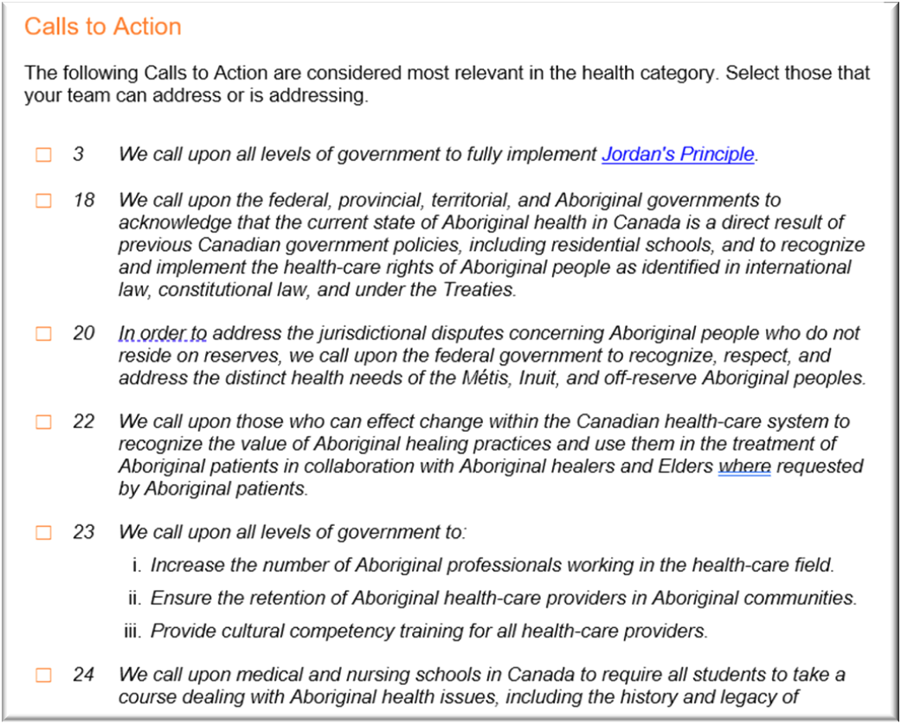
Truth and Reconciliation Principles and Calls to Action - Reflection
Refer to Page 3-6 of the TR Tool
Notes:
The TRC’s mandate was to inform all Canadians about what happened in residential schools. The TRC documented the truth of Survivors, their families, communities, and anyone personally affected by the residential school experience.
​
In 2015, the TRC published its final report detailing the experiences and impacts of the residential school system, creating a historical record of its legacy and consequences.
One outcome of the report was a document detailing 10 Principles of Reconciliation and 94 Calls to Action which set out direction for making amends for the legacy of the residential school system in order to advance the process of reconciliation in Canada. These help guide reconciliation and close the gap in health outcomes between Indigenous and non-Indigenous people.​
​
We will first reflect on the 10 Principles.

Slide 18
Addressing the Principles of Reconciliation and Truth and Reconciliation Calls to Action
Refer to Page 6 of the TR Tool
Notes:
Let’s discuss and identify how the team can address and/or is addressing the Principles of Reconciliation. Some questions to facilitate the team’s discussion are:​
What can your team do improve equity of health services between Indigenous and non-Indigenous peoples?​
How can you better training staff support their understanding of Indigenous health system experiences?​
What are some tasks you can do to help your team better understand the Rights of Indigenous peoples?
​Facilitation notes
Ensure the team is identifying any opportunities, considerations, activities, partnerships, agreements, interdependencies, etc. related to the Principles.
Ensure the team is discussing potential actions to add to the strategic plan, annual operating plan, and work plan.
EXAMPLE RESPONSES FOR REFERENCE
​Northern - Integrating planning process with the end user experience (Indigenous lens)
​SHSS - An example of this is that we have engaged Indigenous Elders to facilitate ground blessing ceremonies for each of the capital projects as new projects build medical facilities on land within the region. This ceremony was attended by health leaders from SHSS and Shared Health.
​PMH –PMH has a dedicated Indigenous relations leader to engage with the 14 communities within the region

Slide 19
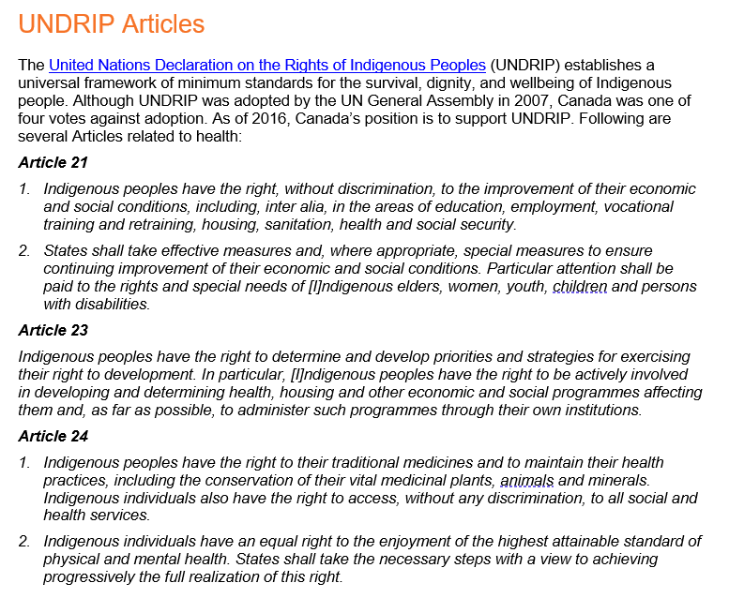
UNDRIP Articles – Reflection and addressing the Articles
Refer to Pages 6/7 of the TR Tool
Notes:
Speaking notes
The United Nations Declaration on the Rights of Indigenous Peoples, or UNDRIP, is the culmination of decades of effort dating back to 1982. Although UNDRIP was adopted by the UN General Assembly in 2007, by a majority of 144 states in favour, Canada was one of four votes against adoption. As of 2016, Canada’s position is to support UNDRIP.
UNDRIP establishes a universal framework of minimum standards for the survival, dignity, and wellbeing of the Indigenous peoples of the world, and it elaborates on existing human rights standards and fundamental freedoms as they apply to the specific situation of Indigenous peoples.
UNDRIP contains three Articles related to health.

Slide 20
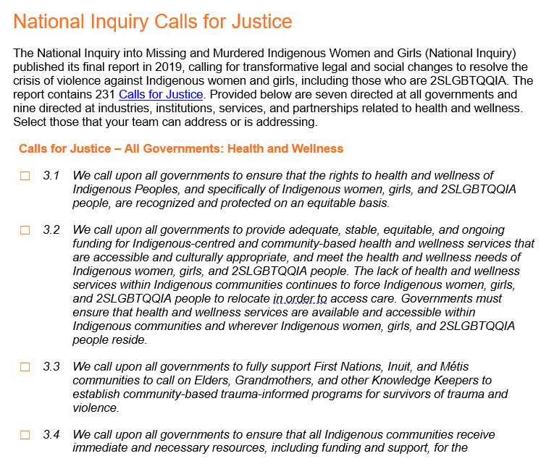
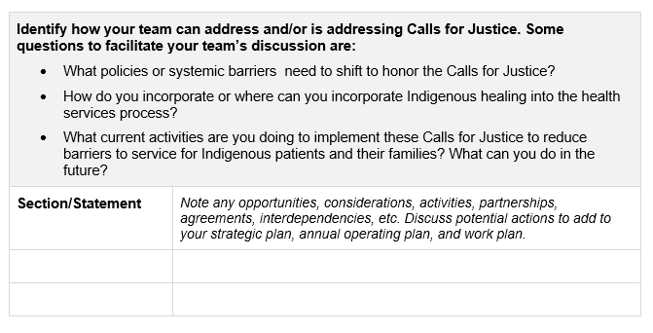
National Inquiry Calls for Justice – Reflection and Addressing the Calls for Justice
Refer to Pages 7-10 of the TR Tool
Notes:
Speaking notes
The National Inquiry into Missing and Murdered Indigenous Women and Girls (National Inquiry) officially commenced in September 2016 with a mandate to investigate and report on the systemic causes of all forms of violence against Indigenous women and girls, including those who are 2SLGBTQQIA.
The National Inquiry published its final report in 2019 which revealed that “persistent and deliberate human and Indigenous rights violations and abuses are the root cause behind Canada’s staggering rates of violence against Indigenous women, girls, and 2SLGBTQQIA people”.
The report calls for transformative legal and social changes to resolve this crisis and contains 231 individual Calls for Justice directed at governments, institutions, social service providers, industries, and all Canadians.
Among these Calls for Justice are 7 directed at all governments related to health and wellness.
There are also 9 directed at industries, institutions, services, and partnerships related to health and wellness service providers.

Slide 21
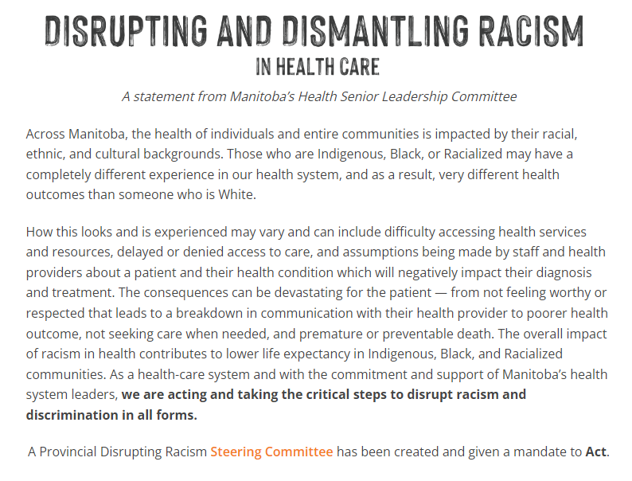
Disrupt Racism Commitment – Addressing the Commitment
Refer to Page 10/11 of the TR Tool
Notes:
Speaking notes
With the commitment and support of Manitoba’s health system leaders, the healthcare system is acting and taking the critical steps to disrupt and dismantle racism and discrimination in all forms. A Provincial Disrupting Racism Steering Committee has been created and given a mandate to act.
Four working groups (Racial Climate Survey, Engagement, Policy and Communications) have been created, focused on the initial foundation of a more inclusive, equitable and safe health system.
Together, we will:
Improve access to information and enhance learning – by supporting the collection of race, ethnicity and Indigenous identity data to support health systems planning and learning; hosting educational and learning-based events that allow health-system staff to engage in critical self-reflection and learning; and developing and sharing resources that will support improvements in equity, access and experience.
Engage community, staff and patient/public groups for input in the development of an anti-racism action plan. Working in partnership with Indigenous, Black and Racialized community members; collecting the experiences of patients/residents/clients, families, staff, physicians, volunteers and learners; and incorporating their guidance.
Develop and implement policies and procedures to ensure the creation of safe care environments, through meaningful Indigenous reconciliation; by encouraging and supporting those who speak out against racism and discrimination; and through the creation of safe reporting options and action against acts, words or actions that violate existing policies and protocols.
Create and share resources, materials and reminders that support education, awareness, and change.

Slide 22
Disrupt Racism Commitment – Addressing the Commitment
Refer to Page 11 of the TR Tool
Notes:
Speaking notes
Let’s discuss and identify how the team can address and/or is addressing the Principles of Reconciliation. Some questions to facilitate the team’s discussion are:
What can your team do improve equity of health services between Indigenous and non-Indigenous peoples?
How can you better training staff support their understanding of Indigenous health system experiences?
What are some tasks you can do to help your team better understand the Rights of Indigenous peoples?
Facilitation notes
Ensure the team is identifying any opportunities, considerations, activities, partnerships, agreements, interdependencies, etc. related to the Principles.
Ensure the team is discussing potential actions to add to the strategic plan, annual operating plan, and work plan.
EXAMPLE RESPONSES FOR REFERENCE
Northern - Integrating planning process with the end user experience (Indigenous lens)
SHSS - An example of this is that we have engaged Indigenous Elders to facilitate ground blessing ceremonies for each of the capital projects as new projects build medical facilities on land within the region. This ceremony was attended by health leaders from SHSS and Shared Health.
PMH –PMH has a dedicated Indigenous relations leader to engage with the 14 communities within the region

Slide 23
Truth and Reconciliation Tool – session 2 Adding Actions to Annual Plans
Preparation for the next team session:
Choose a date for session 2
*Team Lead* - Prior to session 2:
Review the contents of the completed tool and share with all team members
Have team members review annual planning documents looking for alignment
At session 2:
Recap of session 1
Review last session – facilitator to review completed tool and notes the last session
Purpose of this session is to summarize which items will go into the planning documents
At the end of session 2 – plan next steps forward

Slide 24
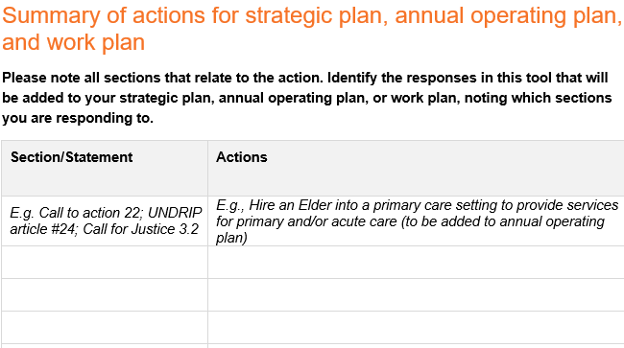
Summary Exercise
Refer to Page 11 of the TR Tool
Notes:
Speaking notes
Given the discussion on the legislation and guidance, what are the top three items we could action that we would like to prioritize and include in our strategic plan, annual operating plan, and work plan.

Slide 25
Next Steps
Between now and session 2:
Review the actions for the team to complete as identified in the T & R tool
Review annual plans to confirm where the tasks fit
After session 2:
Develop Indigenous partnership engagement plan
Develop communication and engagement plan for team
Identify Indigenous partners to engage
Update strategic plan, annual operating plan, and work plans as required

Slide 26
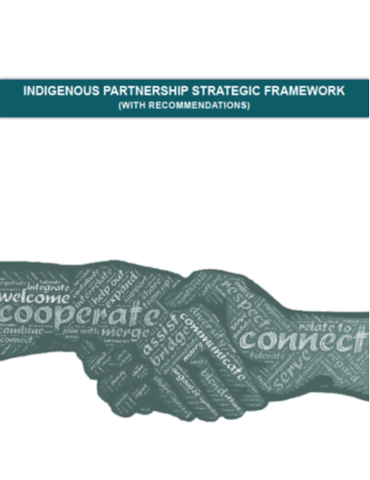
Resources
Resource Links:
Video
The Path to Reconciliation Act
Truth and Reconciliation Principles of Reconciliation
Truth and Reconciliation Calls to Action
UNDRIP Articles
What we learned to date report on the implementation of the United Nations Declaration on the Rights of Indigenous Peoples Act
The United Nations Declaration on the Rights of Indigenous Peoples Act Action Plan
National Inquiry Calls for Justice
Disrupt Racism Commitment
Indigenous Partnership Strategic Framework (Click on Image)

