Slide 1
What Does Ethics Have To Do with It?
And what does it have to do with me?
By: Cara Corvino Provincial Ethics Lead, Shared Health
Notes:
Talk about who you are and your background

Slide 2
Overview
What is (and is not) Ethics
What does Ethics in Healthcare look like?
What is the Provincial Ethics Service?
Priorities, Initiatives and Resources
Looking back on 2024
Take away

Slide 3
What is (and is not) Ethics?
Ethics is….
The process of balancing principles and values to guide difficult decisions by determining what we should do, why we should do it, and how we should do it.
What Ethics is not…
A fixed set of rules.
Determining what is the right or wrong.
Going above the law.
Ignoring policies or procedures.
Limited to patient care alone.

Slide 4
Values and Principles
Values
Fairness
Quality
Respect
Transparency
Caring
Responsibility
Trust
Longevity
They guide our actions and decision making
They are shaped by our culture, beliefs, community, religion, and life experiences
Organizations and institutions have their own set of values.
Principles
Autonomy
Beneficence
Non-Maleficence
Justice
…………..
Truth telling
Confidentiality
Part of normative theory
Not dependent on ones subjective view points.
They justify or defend our actions.

Slide 5
Moral Distress
Conflict of values.
Constraints can be internal or external
It occurs when you feel constricted from taking the right course of action.
It leads to feeling that your moral agency is limited
Internal Constraints
Lack of confidence in role
Religious/cultural conflicts
Perceived powerlessness
External Constraints
Lack of cooperation
Poor communication
Inadequate staffing
Examples of Moral Distressing Situation
Limited Resources
Changing technology
Communication challenges
Outdated policies

Slide 6
What Does Ethics in Healthcare Look Like?
Hot Topics
Pandemics
Medical Assistance in Dying
Futile Care
Limited resources
Experimental drugs
Pushing the age of viability
Advances in technology

Slide 7
What Does Ethics in Healthcare Look Like?
Its not just about the hot topics!
Trust
Informed consent
Privacy/patient confidentiality
Justice
Transparency.

Slide 8
Case Study
You and your team are tasked with overseeing the implementation of a new electronic health record (EHR) system aimed at improving operational efficiency, care coordination, and data accessibility for healthcare providers. The new system promises significant benefits.
As positive as you had been about the roll out you are starting to realize that the new system has some challenges you and your team had initially not explored. Your team starts to hear from staff that as the Clinicians and administrative staff are going through training some resist due to a lack of familiarity with the technology, fearing it will disrupt their workflow. Patients are also voicing their concerns during the initial phase of implementation. Some have concerns about the potential uses of their data, such as whether it could be shared with third parties or used for research purposes. Others, particularly those with stigmatized medical conditions, raise questions about the security of their sensitive information. On top of these concerns a valid question was posed at your most recent provincial meeting with the other Health Authorities related to disparities in access among different patient populations. Patients in rural or underserved areas struggle to use the online portal due to limited internet access or digital literacy.
You realize you might need to reconsider how you continue to roll out the new EHR system to address some of these concerns. Your team meets and discusses some of the ethical considerations and how best to address them.

Slide 9
Broadening Our Thinking About Ethical Issues
What are the ethical considerations?
Trust
Informed consent
Privacy/patient confidentiality
Justice
Transparency.

Slide 10
Provincial Ethics Service
The Provincial Ethics Service collaborates with all areas of Shared Health, Health Authorities, and Service Delivery Organizations (SDOs) to integrate an ethical lens into all levels of healthcare, from bedside to boardroom.

Slide 11
Provincial Ethics Service
Decision Making
Policy Development
Education, Tools, Resources
Organizational Ethics
The Provincial Ethics Service is a dedicated resource designed to support ethical decision-making across healthcare, and community organizations within the province. It provides expertise in addressing complex ethical issues that arise in clinical practice, policy development, and organizational governance.

Slide 12
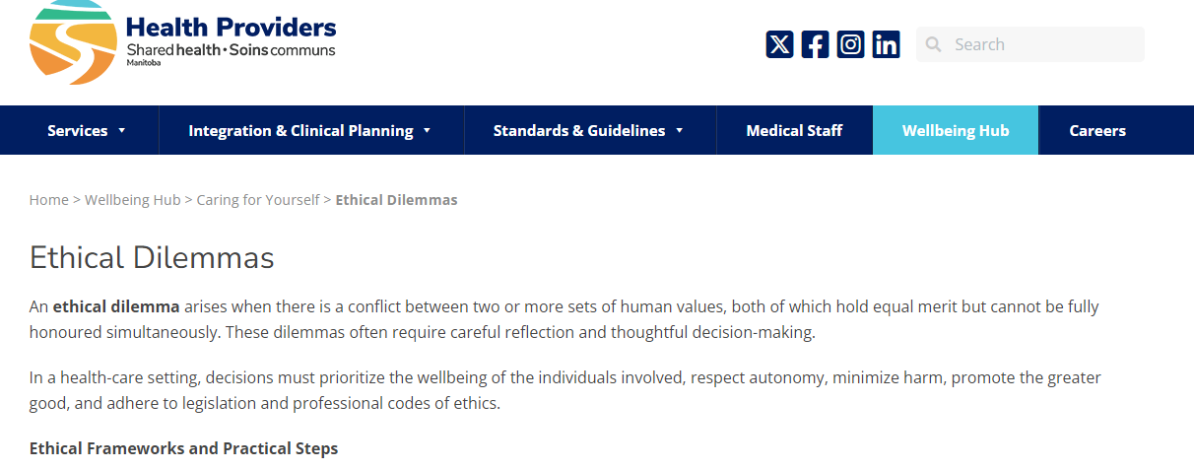
Priorities, Initiatives, and Resources
Priorities
Ethical Decision Making Framework/Guide
Provincial Ethics Working Group
Supporting Ethics Committees
Ethics Education
Initiatives
Moral distress debrief
Complex/long stay patients
Shared Health Wellness Team
Resources
Ethics Frameworks
Ethics Committees
Ethics Education Series
Provincial Ethics Service, St. Boniface Ethics Service, Ethicist at HSC

Slide 13
Looking Back on 2024
Ethics Education Series
For clinical and non-clinical staff, as well as interested family members and patients.
Offered multiple times a month on various topic.
Education | Health Care Ethics
Annual Ethics Workshop
Going the Distance – From Hospital to Home: The Ethical Complexities of Discharge.
In person speakers, case study review in groups, panel discussion.
Plan for next year.
Personalized Presentations
Common themes: moral distress, duty to care and dignity of risk, sexual expression in LTC, harm reduction.
Supporting Ethics Committees.

Slide 14
Take Away
If you are….
Struggling to determine the right course of action.
Asking a “should” question.
Feeling that there is conflict in values or beliefs.
Feeling uncomfortable with a decided course of action.
Reach out to…..

Slide 15
Thank you!
Questions, Comments, Feedback
Cara Corvino RNBN MHSc
Shared Health, Provincial Ethics Lead
Email
ccorvino@sharedhealthmb.ca
Phone number
431-323-8082

