Slide 1
Shared Health ED Overcrowding – The Manitoba Picture
Performance and Monitoring November 4, 2024
sharedhealthmb.ca

Slide 2
Challenges/Impacts of Overcrowding in Manitoba's Emergency Departments
Emergency Departments (ED) across Canada are under strain and experiencing overcrowding
Manitoba is experiencing significant challenges in staffing and high patient acuity/health system demand
Demand for health services exceeds capacity
Key ED metrics (wait time, wait to be admitted, LOS) trending negatively
Impacts on quality and standard of care
Factors internal and external to the ED contribute to overcrowding

Slide 3
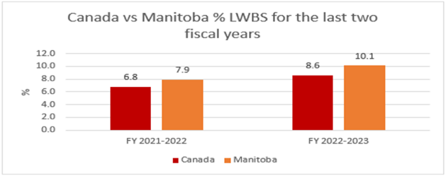
Emergency Department Performance Indicators
ED Wait Time for Initial Physician Assessment (90th percentile hours), 2019/20 to 2022/23
HSC: 4.4 7.2
WRHA: 5.1 7.5
Canada: 4.1 5.0
ED Length of Stay (90th percentile hours), 2019/20 to 2022/23
HSC: 29.1 47.9
WRHA: 45.0 62.5
Canada: 38.3 49.0
Left Without Being Seen:

Slide 4
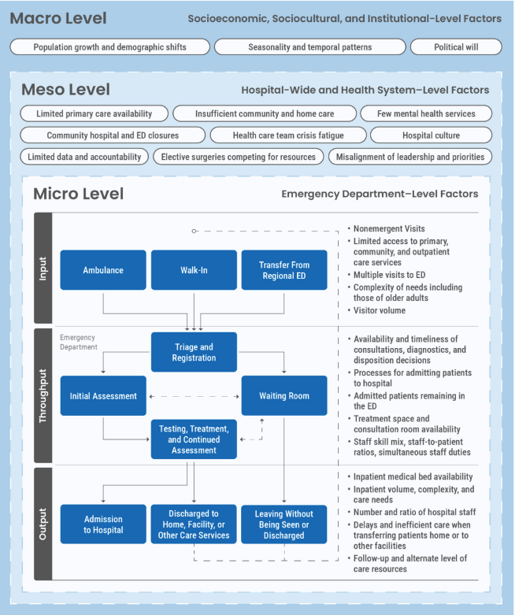
Leveraging CDA's Work
In Nov 2023, Canada’s Drug Agency (formerly CADTH) published cross- jurisdictional evidence reviews on ED Overcrowding
Environmental scan of contributing factors to
overcrowding
Identified three categories of factors:
Micro – Factors applicable at ED level
Meso – Factors applicable hospital wide
and at health system level
Macro – Broader socioeconomic,
sociocultural and institutional level
How can we measure these factors in Manitoba?

Slide 5
Micro Level Contributing Factors
Divided in to:
Input Factors – Factors influencing need for ED Services
Throughput Factors – Focused within the ED
Output Factors – Patient Disposition
Input | Throughput | Output
Primary Care and Community Health Services | Consultation, Testing and Decision Delays | Boarding and access block
Repeat Visits and Low-Acuity Visits | Staff Considerations | Demand on hospital resources outside of ED
Growing Patient Volumes and Complexity of Needs | Barriers to Optimal operational efficiency | Impediments to exiting ED
Access Via multiple avenues

Slide 6
Meso/Macro Level :
Contributing Factors
Meso - Hospital and Health System Wide:
Limited post-acute care and ALC resources (homecare and PCH beds)
Limited primary care resources
Hospital culture
Limited mental health and substance use resources
Rural Community hospital closures
Limited inpatient workforce
Macro - Socioeconomic, Sociocultural and Institutional Level:
Population Growth and Demographic Shifts
Seasonal and Temporal patterns
Homelessness

Slide 7
Manitoba's Current Landscape
Data-driven need to quantify issue to inform planning and action in MB
Identify readily available metrics in alignment with micro, meso, and macro factors
Analyzing baseline and trending data to identify existing and emerging issues
Manitoba overall and drilling down to region and site level
Need to take in to account impact of COVID on ED activity

Slide 8
Micro Level
Factors Applicable to Emergency Department

Slide 9
Micro/Input: Growing Patient Volumes
Stable volumes pre COVID
Since 2020 volumes have increased by 12% or 64K in Manitoba overall, and;
7% or 20K at Winnipeg ED/UCC sites
Still below pre-Covid levels: 30K less people presenting to our EDs in 2023 compared to 2018 and 2019
*
*incomplete rural data

Slide 10
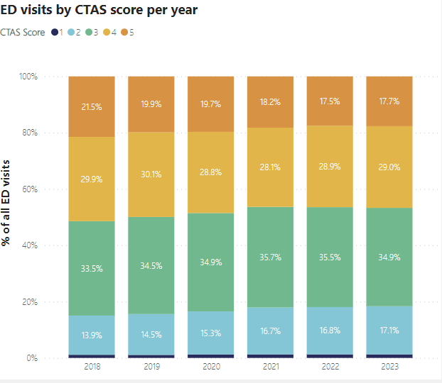
Micro/Input: Growing Patient Volumes and Acuity
Distribution across CTAS has changed from 2018 to 2023
CTAS 4/5 – low acuity:
51.4% to 46.7%
Decrease of 40K visits
CTAS 1/2 – high acuity:
15.1% to 18.4%
Increase of 16K visits
Indicates increase in acuity of patients

Slide 11
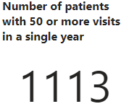
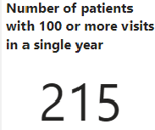
Micro/Input: Repeat Visits to ED
After a drop in 2020, number of unique patients presenting 5+ times in a year is trending upward (+14% increase) in last 4 years
7+ times – 14% increase
9+ times – 16% increase
11+ times – 19% increase
Proportion of total Visits by patients presenting 5+ times in a year has been steady at about 28% to 30%

Slide 12
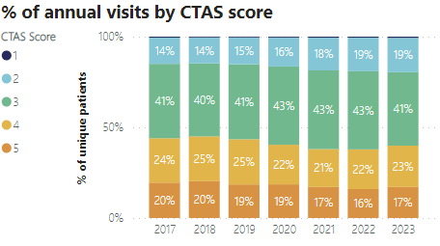
Micro/Input: Repeat Visits to ED
Individuals Presenting 5+ times in a year
About 40% of patients presenting 5+ times per years are presenting as a CTAS 3 (urgent)
CTAS 2 presentations have increased from 14% of total visits in 2017 to 19% in 2023. This represents an increase of 14k CTAS 2 cases since 2017 and 9.3k cases since 2020

Slide 13
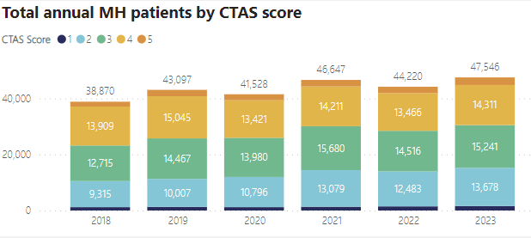
Micro/Input: Mental Health and Substance Use Presentations
Overall, the annual number of presentations for Mental Health and Substance Use has increased by 22%, or 8.7K visits, from 2018 to 2023
Largest increase is in the CTAS 2 presentations; 47% increase in volumes from 2018 to 2023

Slide 14
Micro/Input: Patients Experiencing Homelessness

Slide 15
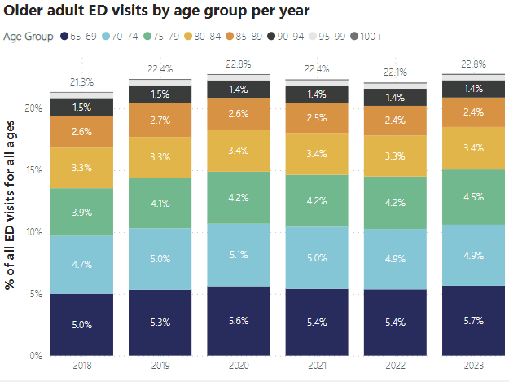
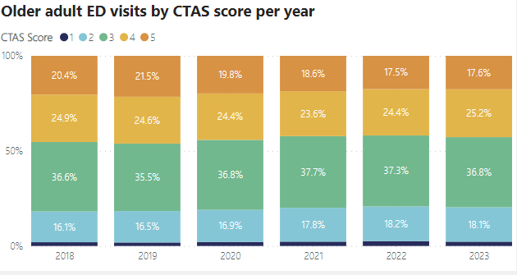
Micro/Input: Older Adults
The 65+ age group made up about 22.8% of total ED presentations in 2023; slight increase from 21.3% in 2018
Represents a small volume increase of 1.3K visits
CTAS 4/5:
45.3% to 42.8%; 60.1K to 57.4K
CTAS 1/2:
18.1% to 20.4%; 24.0K to 27.4K
Possibly indicates a slightly higher acuity patient population

Slide 16
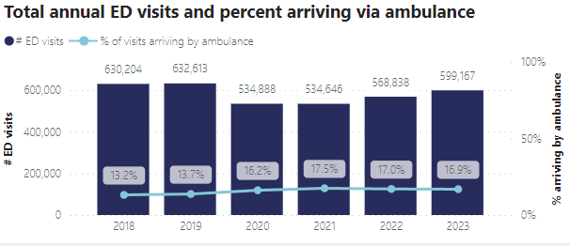
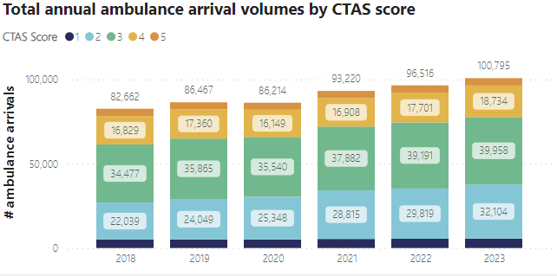
Micro/Input: Ambulance Arrival
Manitoba Overall:
The proportion and volume of arrivals via ambulance increased from 2018 to 2023
13.2 % to 16.9%
82.6K to 100.8K
The largest increase is in CTAS 2 presentations via Ambulance:
Increase of 46% or 10K cases
For Winnipeg sites:
Increase in ambulance arrivals:
9.4% to 11.3%
59K to 67.5K
CTAS 2 Increase of 49% or 7.5K cases
Admission rates for Ambulance Arrivals:
MB and Wpg: decrease from 28% to 25%
only slight increase in volumes

Slide 17
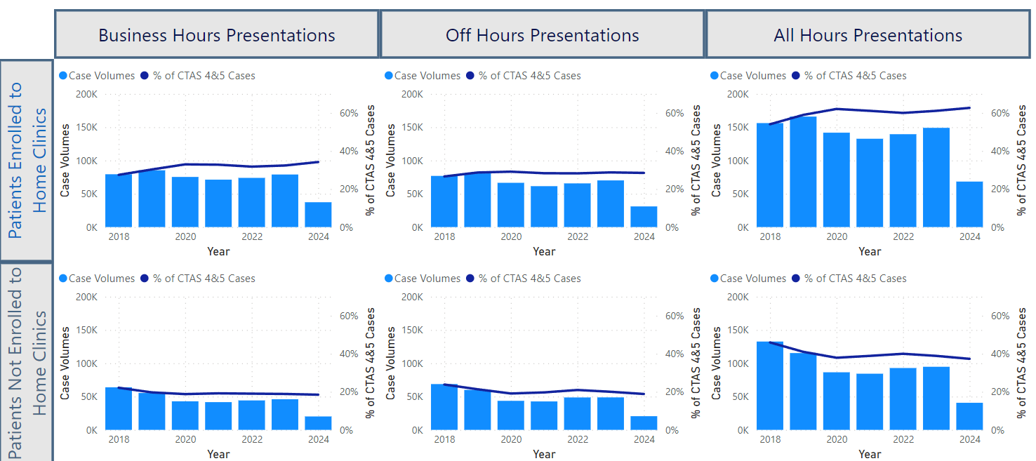
Micro/Input - ED Low Acuity Visits vs. Access Primary Care Home Clinics
CTAS 4/5 presentations:
Patients enrolled to a Home Clinic vs Patients Not enrolled
Presentations during typical PC business hours (M-F, 8:00 to 18:00) vs off Business Hours (evenings, weekend)
Increasing trend in proportion of individuals presenting at ED as CTAS 4/5 during PC business hours who are enrolled to PC Home Clinic: 27.4% to 34.2%; 79K cases in 2023
For any day/time, the proportion of individuals presenting at ED as CTAS 4/5 who are enrolled to PC Clinic is increasing:
54% to 62.7%; 149K cases in 2023
For patients not enrolled in a PC Home Clinic, their proportion of CTAS 4/5 visits has decreased:
PC Business Hours: 22.1% to 18.5%
All Hours: 46% to 37.3%
47% of CTAS 4/5 presentations occur on evenings and weekends for both enrolled (28.5%) and non-enrolled (18.9%) patients; 118.9K cases in 2023

Slide 18
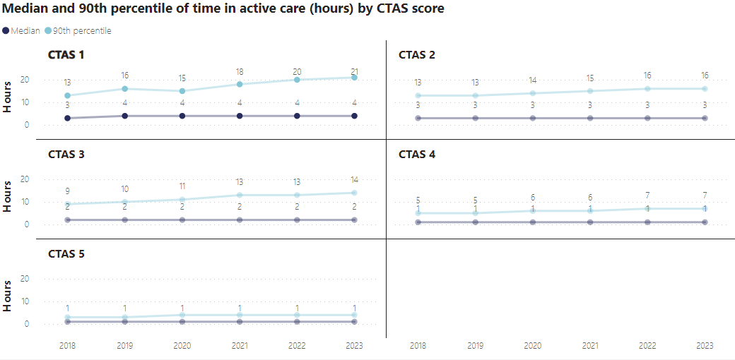
Micro/Throughput : Disposition Decision Delays (Time in Active Care)
Time in Active Care is the number of hours between ‘time of first treatment in progress’ and ‘time of disposition decision’
Median times are relatively flat over time across all CTAS levels
The 90th Percentile has increased across all CTAS levels with the exception of CTAS 5
The longest 90th percentile is with the CTAS 1 cohort

Slide 19
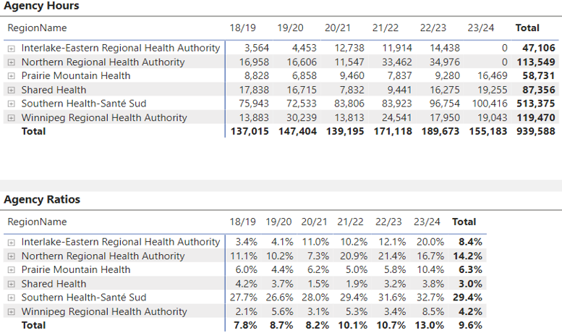
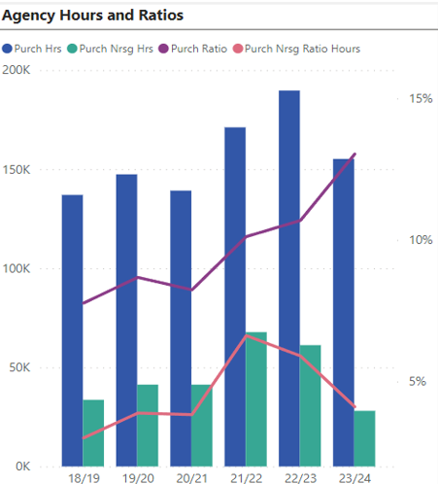
Micro/Throughput: Staff Considerations
(Use of Agency Resources)
Increased dependency on agency staff in ED from 18/19 to 23/24
Agency Ratio: 7.8% to 13.0%
Rural SDOs relying more heavily on agency resources than Winnipeg sites

Slide 20
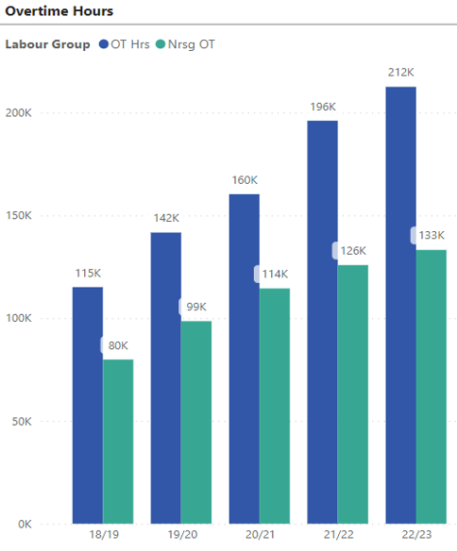
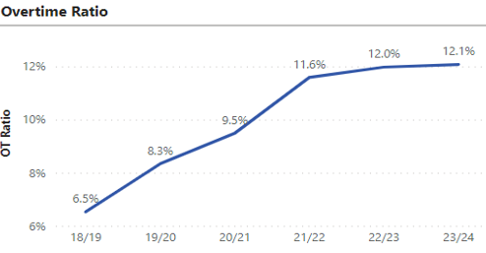
Micro/Throughput: Staff Considerations
(Overtime ED Staff)
Increasing steadily year-over-year since 2018/19 from 6.5% of paid hours being at OT rates to 12.0% in 2022/23
Preliminary data indicates this ratio will remain high once 2023/24 numbers are finalized

Slide 21
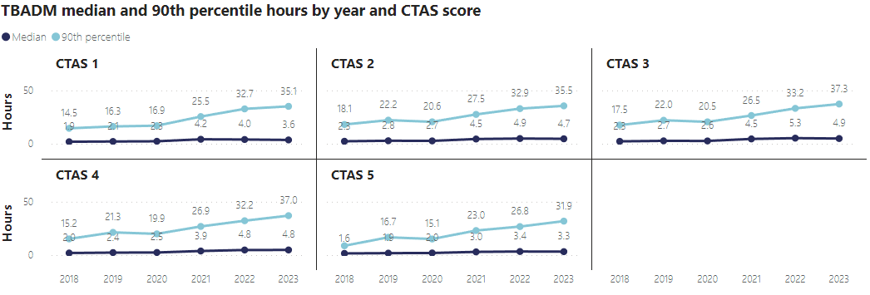
Micro/Output: Boarding Time
Time to be Admitted (TBADM) – Time between when a decision to admit a person is made and when the patient physically leaves the ED for an inpatient bed
Manitoba Overall
The median and 90th percentile TBADM has increased across all CTAS levels from 2018 to 2023
The 90th percentile has increased significantly across all CTAS levels, specifically since 2020 and sits at 30+ hours across all acuity levels

Slide 22
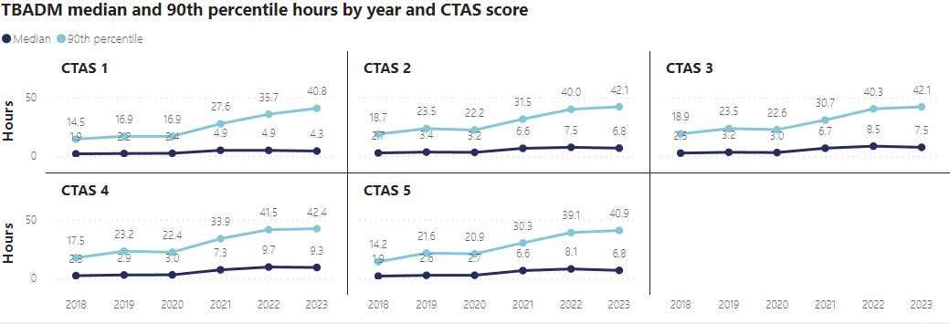
Micro/Output: Boarding Time
Time to be Admitted (TBADM) – Time between when a decision to admit a person is made and when the patient physically leaves the ED for an inpatient bed
Winnipeg Sites
The median and 90th percentile TBADM has increased across all CTAS levels from 2018 to 2023
The 90th percentile has increased significantly across all CTAS levels, specifically since 2020 and sits at 40+ hours across all acuity levels

Slide 23
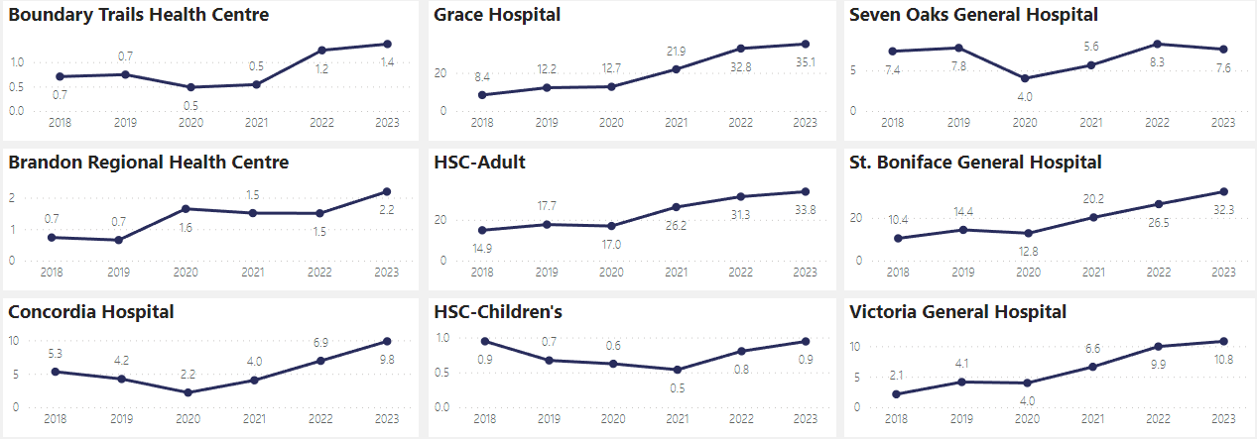
Micro/Output: Access Block
Access Block– Average daily number of patients waiting 12+ hours for an inpatient bed
Across the Province, the average daily number of patients waiting 12+ hours for an inpatient bed has more than doubled from about 79 in 2018 to 201 in 2023
In 2023, the sites with the highest daily averages were Grace (35.1), HSC-Adult (33.8), St. Boniface (32.3), Victoria (10.8) and Concordia (9.8)

Slide 24
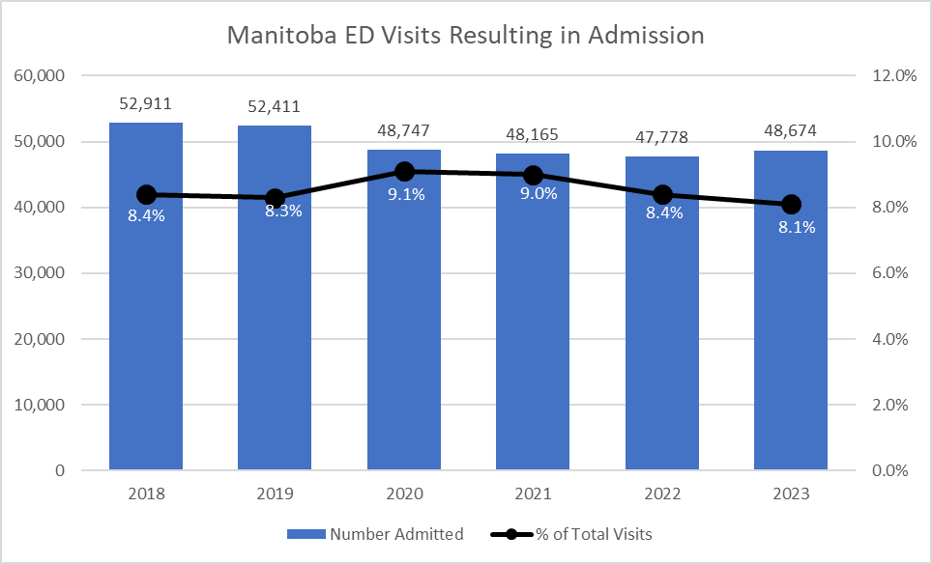
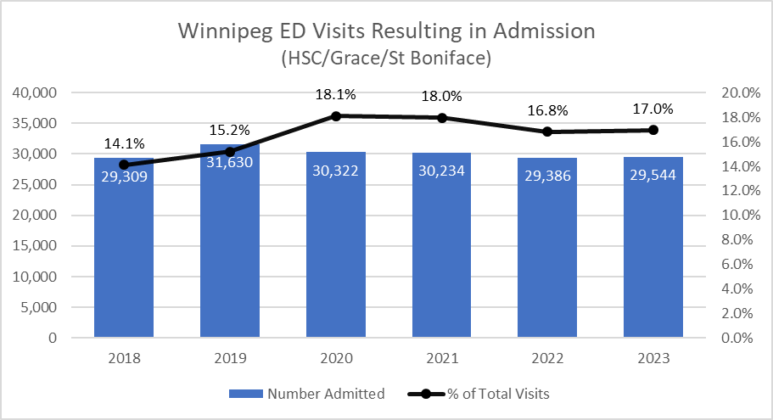
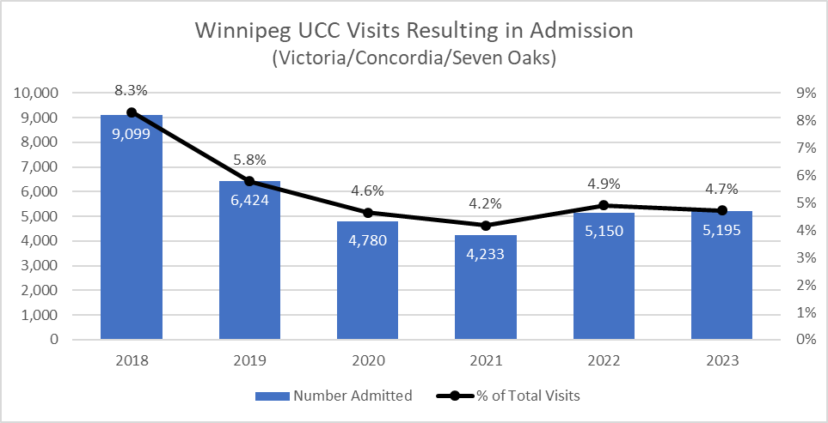
Micro/Output: Inpatient Admissions
After decreasing in 2020, the volume of ED visits resulting in an inpatient admissions has remained stable across Manitoba
The percentage of total ED visits resulting in Admission has been decreasing from a high of 9.1% in 2020 to 8.1% in 2023
At Winnipeg ED sites, the percentage admitted increased to 18% in 2020 and has remained relatively flat since then
The percentage dropped to 4.6% from Winnipeg Urgent Care sites and has remained at that level for the last few years

Slide 25
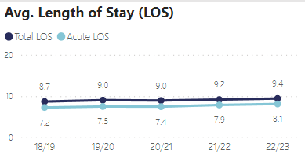
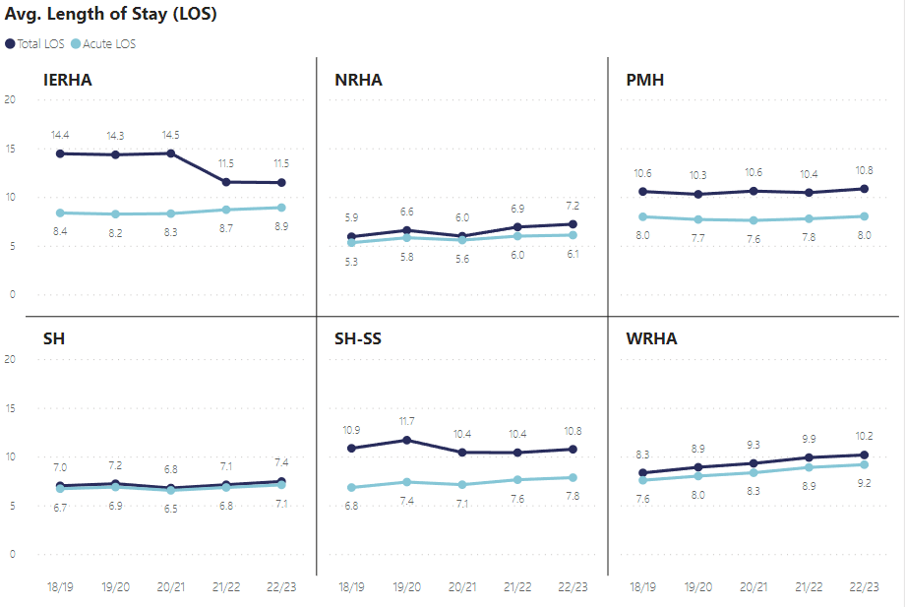
Micro/Output: Length of Stay All Services
Average Length of Stay continues to increase.
The overall Provincial LOS has increased by almost 1 day on average from 18/19 to 22/23
Measure Definition: measure compares total length of stay in hospital to acute length of stay the difference in length of stay is Alternate Level of Care (ALC) length of stay, all ALC LOS is considered conservable.

Slide 26
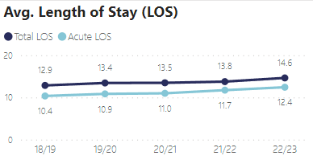
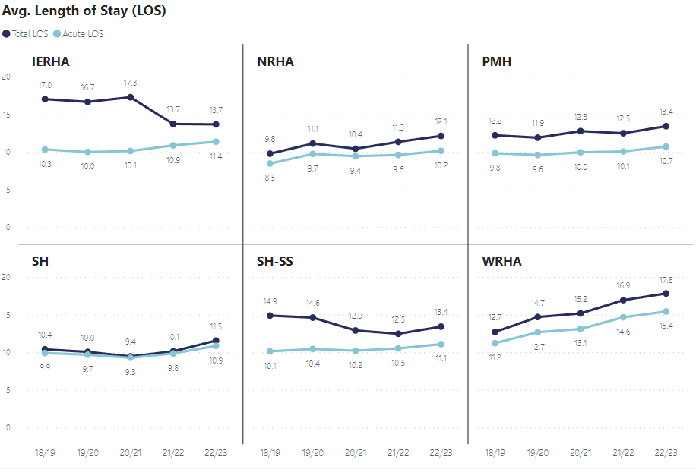
Micro/Output: Length of Stay (Medicine Service)
Average Medicine LOS has been steadily increasing across the Province
WRHA sites have seen a significant increase of about 5 days from 2018/19 to 2022/23
HSC has also seen an increase in medicine LOS; about 2 days since 20/21
Measure Definition: measure compares total length of stay in hospital to acute length of stay the difference in length of stay is Alternate Level of Care (ALC) length of stay, all ALC LOS is considered conservable.

Slide 27
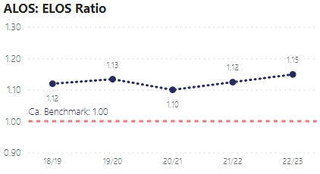
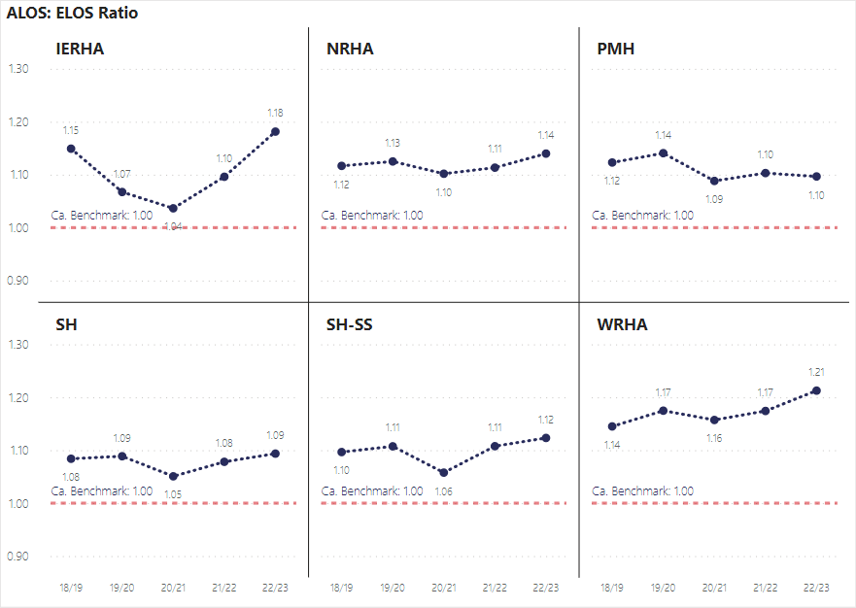
Micro/Output: ALOS:ELOS Ratio (All Services)
ALOS:ELOS Ratio remains above the National Canadian Benchmark and increasing.
Understanding this Measure: This measure gauges how efficiently beds are utilized in the hospital. A ratio of actual to expected length of stay which is below 1.00, represents an overall greater than expected efficiency and indicates that more patients are able to be treated for a given inpatient bed.
Measure Definition: ALOS:ELOS measure compares actual length of stay in hospital to expected length of stay based on comparison to similar patients in national databases.
ALOS:ELOS ratio is only applicable to Typical Cases; Cases without the presence of abnormal circumstance i.e. Transfers, Deaths, Sign-Outs.
Typical cases on average make up 60% of all Inpatient volumes.

Slide 28
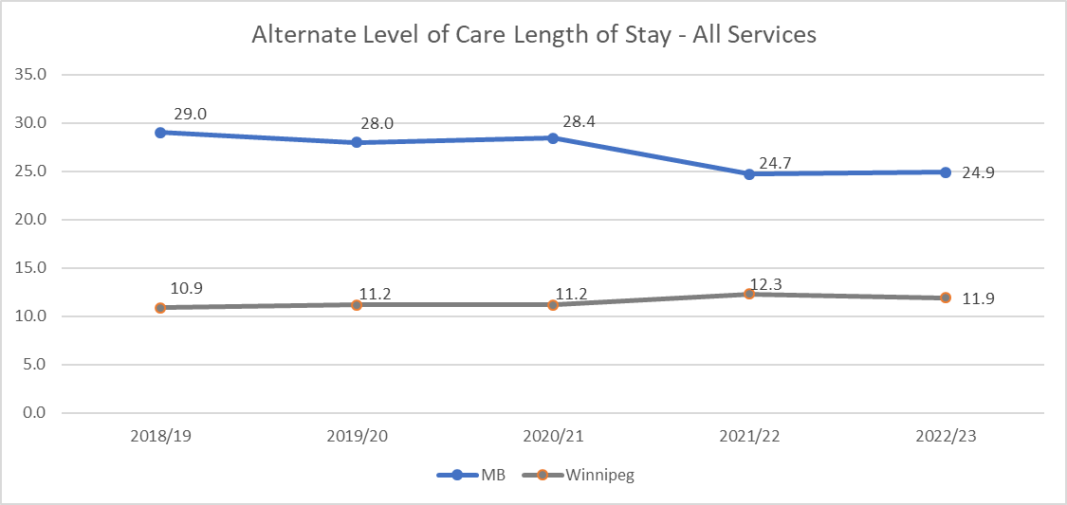
Micro/Output: Alternate Level of Care
After dropping in 2020, ALC volumes have been increasing at Winnipeg sites and across Manitoba
The average ALC length of stays has been decreasing for Manitoba overall, however for Winnipeg sites, there has been a slight increase in the last couple of years
In 2022/23, ALC accounted for 177K patient days in Manitoba; 57K patient days in Winnipeg

Slide 29
Meso Level
Factors Applicable Hospital Wide and Health System Wide

Slide 30
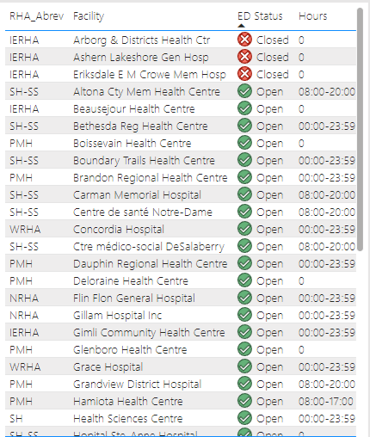
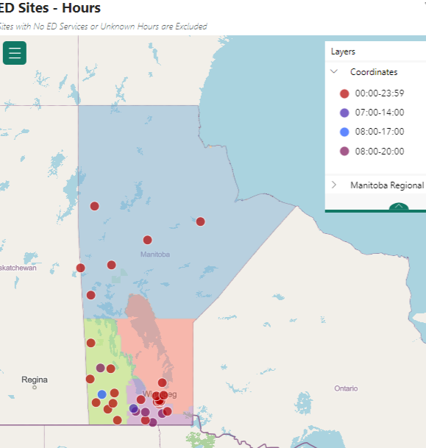
Meso-Level: ED Closures and Limited Hours
Rural Manitoba experiences on-going short term and long term ED closures for a number of reasons
For some sites that are regularly open, hours of operation may be limited to specific times of day or only on specific days
Work is occurring to capture and report hours of operation and service disruption (closures) in a more automated manner through the electronic patient record (EPR) system

Slide 31
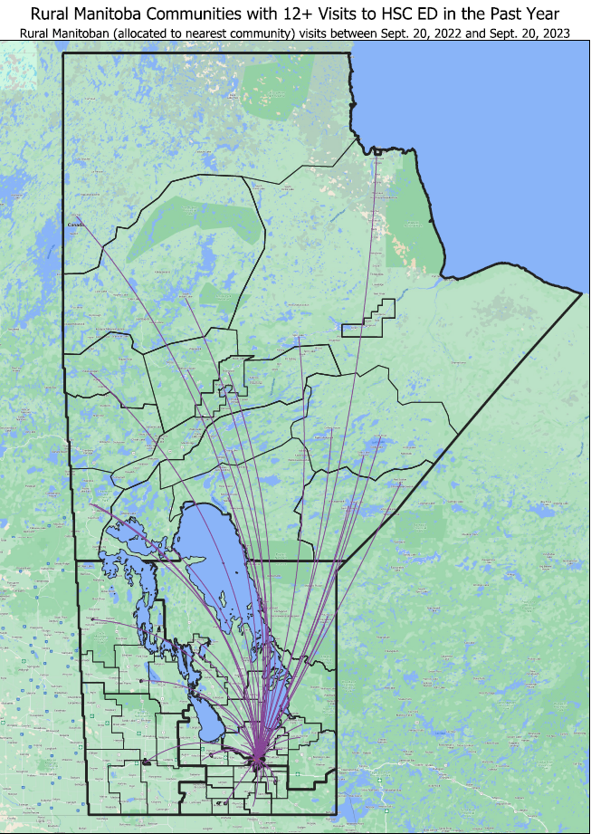
Meso-Level: HSC ED Usage for Rural Patients
Represents 17,787 total visits to HSC ED from residents living outside of Winnipeg
6,802 total visits from residents of Northern Health Region

Slide 32
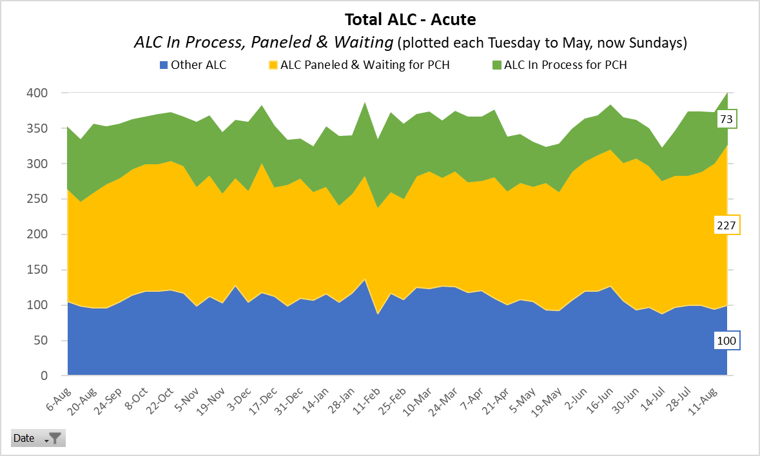
Meso-Level: Limited ALC Resources – Waiting for PCH
The number of individuals in an acute care bed classified as alternate level of care (ALC) is approximately 400 on any given day in the last year
Roughly 50% to 60% of ALC cases on any given day are for individuals Paneled and waiting for a PCH bed

Slide 33
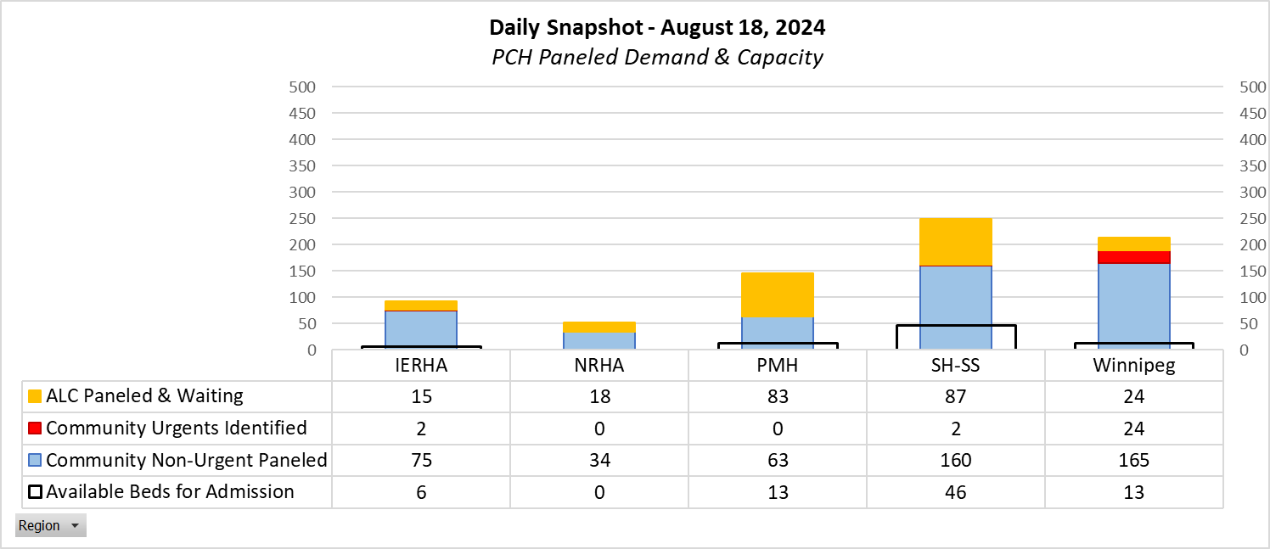
Meso-Level: Limited ALC Resources – PCH Bed Availability
About 300 PCH beds are vacant in Manitoba, but due to closures only about 25% are available for admission (closure data on next slide)
Demand for PCH beds significantly exceeds supply
Example – On August 18th, 2024 there were 752 individuals identified as requiring a PCH Bed while only 78 PCH beds were available to be filled

Slide 34
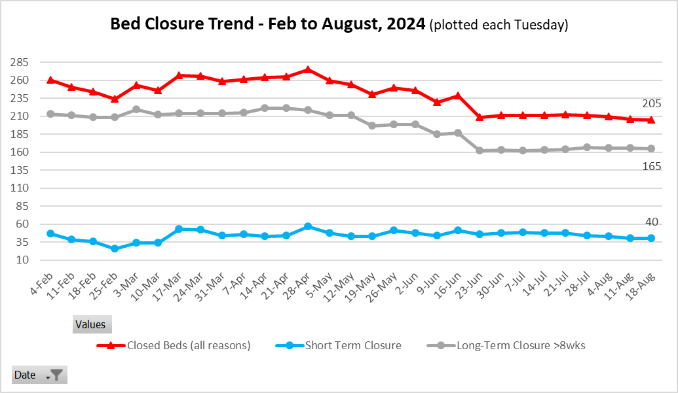
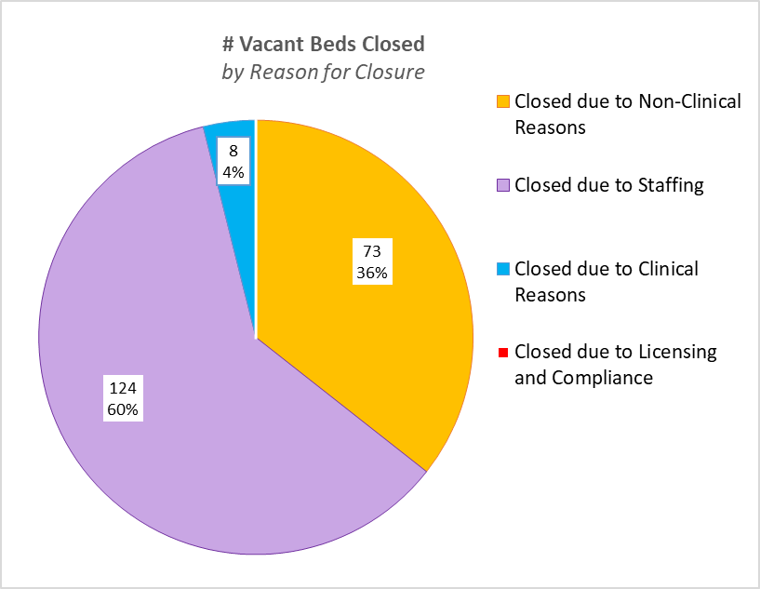
Meso-Level: Limited ALC Resources (PCH Bed Closures)
Since February of 2024, the number of PCH bed closed has decreased, but has remained stable at about 200 over the last couple of months
80% to 90% of closures are classified as long-term (> 8 weeks)
The majority of closures are due to staffing constraints

Slide 35
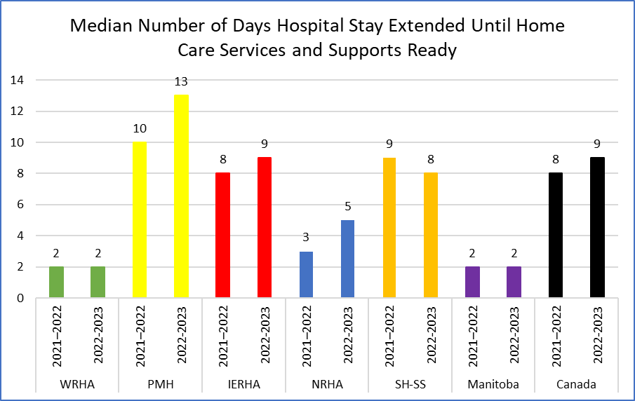
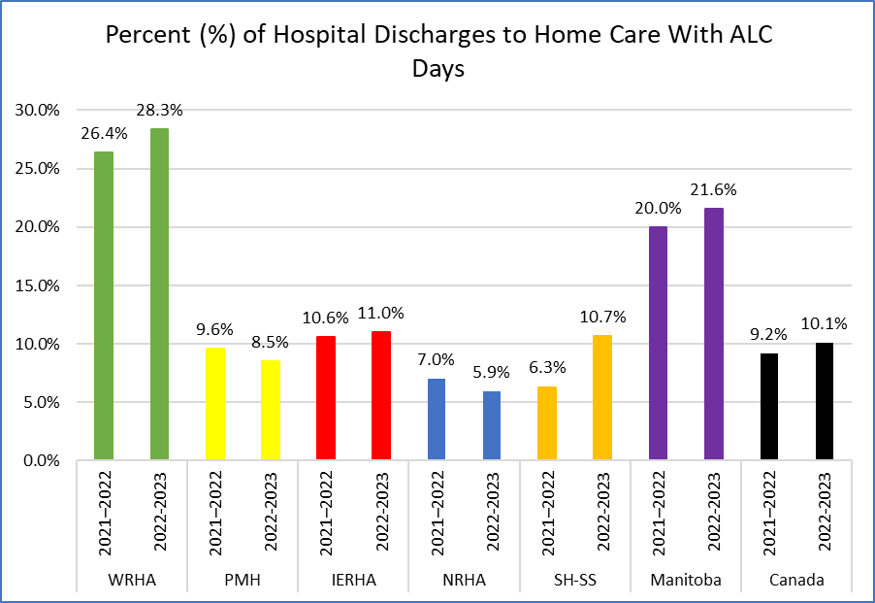
Meso-Level: Access to Home Care Services
Compared to Canada overall, Manitoba has a lower overall median number of days a hospital stay is extended until home care services and supports are ready
However the median does vary across the regions and is highest among PMH residents at 13 days in 2022/23
The percentage of hospital discharges to home care that include an ALC component is at about 22% for Manitoba overall and significantly higher than the Canadian percentage of 10.1%
Rate is primarily driven by the high percentage among Winnipeg residents

Slide 36
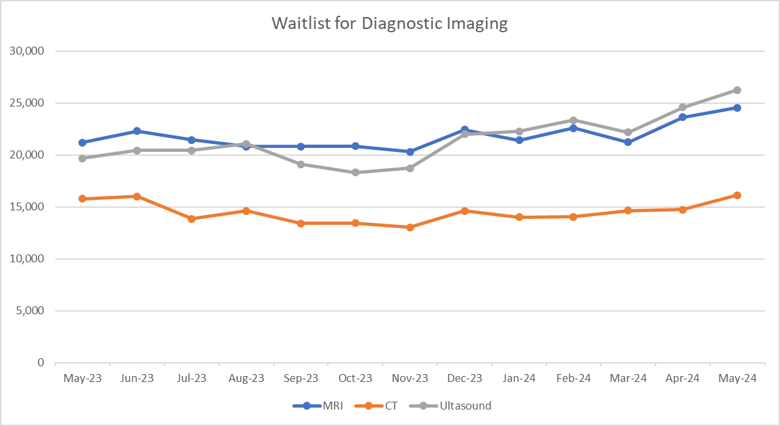
Meso-Level: Limited Availability of Accessing Services Outside of ED (Diagnostic Imaging)
May 2024 Median Wait Times
MRI: ranges from 8 weeks to 47 weeks
CT: ranges from 3 weeks to 23 weeks
Ultrasound: ranges from 2 weeks to 16 weeks

Slide 37
Macro Level
Broader socioeconomic, sociocultural and institutional level factors

Slide 38
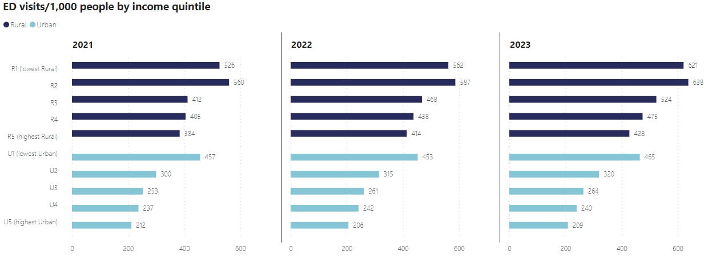
Macro: Presentations by Income Quintiles
The Quintiles are a grouping of the population by average household income. They are first divided into the two categories of Rural and Urban (Winnipeg and Brandon), then further divided into the five groups (quintiles) within each category, with approximately 20% of the population in each group. R1 and U1 represent the lowest income group in the Rural and Urban categories respectively, and R5 and U5 the highest income group
ED utilization varies across income quintiles for both the rural and urban population. Utilization is highest in the lowest income group (R1 and U1) and lowest in the highest income group (R5 and U5).
There is a clear relationship between income and utilization with utilization increasing going from highest income group to the lowest

Slide 39
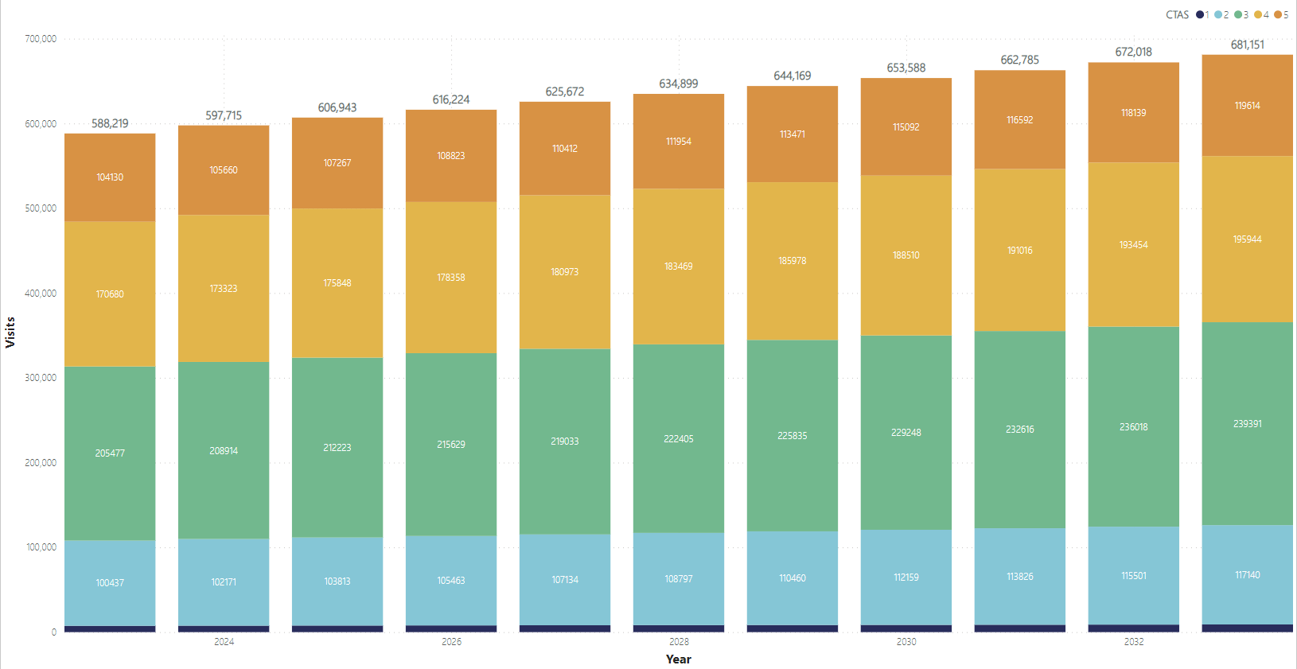
Macro: Population Growth
Projected ED Visits by CTAS
2033
Projected 51,000 more CTAS 1/2 ED visits by 2033 compared to 2023

