Slide 1
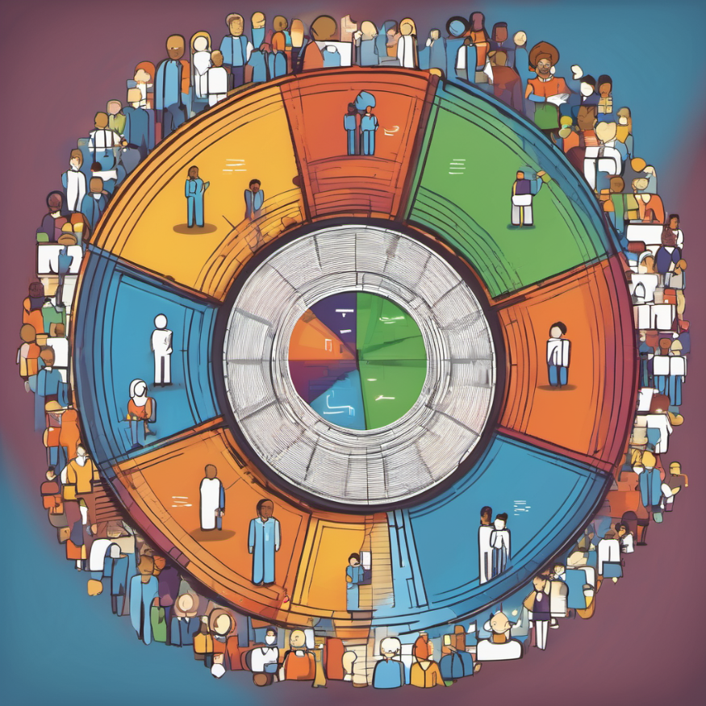
Change Leadership Creating a Change Canvas
CHANGE AHEAD
Notes:
Hello everyone, welcome to the change leadership workshop. Thanks for joining me for this Learning Together session today.

Slide 2
Goals
for
Today
Creating a change canvas - preparing and building support for change
01
Notes:
Our goal for today is provide you with information on change leadership with focus on a project/initiative of your choice.
The topics will include:
“What is change management?”.
Your role as a change leader.
Preparing yourself for change.
Creating a change canvas - preparing and building support for change
Through out these topics we will have the lens of managing change in diverse environments.
We have tried to design the course so that there is lots of activities, so we won’t just be talking at you for the next two hours.
We do have some foundational concepts to cover, but the focus is for us to provide some practical application on change leadership and to hopefully provide you with some skills and tools that you can use on the upcoming bed expansion, and also for any future changes that you may be required to lead employees through.
Any questions about the goals?

Slide 3

Change Leadership
Change leadership is the process of guiding and facilitating organizational change effectively.
It involves a combination of strategic planning, communication, motivation, and support to navigate through transitions within an organization.
Change leaders often inspire and empower employees to adapt to new circumstances, technologies, structures, or strategies.
They play a crucial role in managing resistance to change and ensuring that the organization achieves its desired outcomes during periods of transition.
Notes:
Change leadership is the process of guiding and facilitating organizational change effectively.
It involves a combination of strategic planning, communication, motivation, and support to navigate employees through transitions within an organization.
Change leaders often inspire and empower employees to adapt to new circumstances, technologies, structures, or strategies.
They play a crucial role in managing resistance to change, fostering a culture of innovation, and ensuring that the organization achieves its desired outcomes during periods of transition.
When change leadership is done holistically, it is inclusive of all voices across our diverse workforce – LGBTQI++, neurodiverse, BIPOC, etc.

Slide 4
Role of a Change Leader – Active, Build, Communicate
Be Active throughout the change
Build a coalition for the change
Communicate directly with employees
A
B
C
Be Visible
Be a liaison – engage with and support all impacted groups
Share personal impact messages with direct reports about the change (WIIFM)
Be an advocate – demonstrate support for the change
Be a resistance manager – identify and mitigate resistance to the change
Help your staff see the bigger picture and the reason for the change
Be a coach – help employees through the change process
Engage staff throughout the change where you can
Be transparent and authentic
Clear up questions, confusion, and gossip
Ensure representation of diverse voices throughout the change process
Listen!
Integrating EDI into Communication Strategy

Slide 5
1
Creating a Change Canvas - Preparing and build support for change
CHANGE AHEAD
Session Agenda

Slide 6
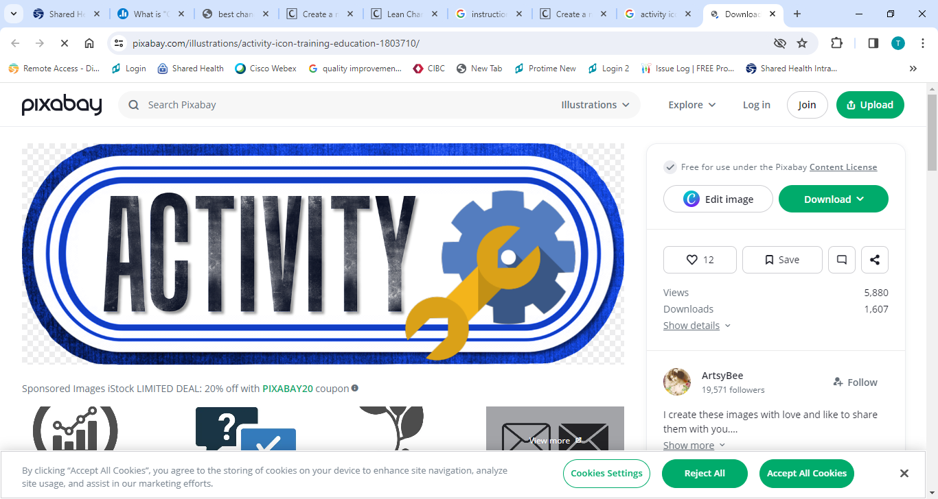















Change Canvas
VISION:
IMPORTANCE: | IMPACT:
READINESS: | CHALLENGES/CHANGE DECTRACTORS:
SUPPORT: | KEEPING IT GOING:
PLAN: NEXT STEPS/ACTION PLAN
1. 5. 2. 6. 3. 7. 4. 8.
Notes:
What is a change canvas - a useful approach for gathering your thoughts and to start mapping out change initiatives.
It’s a tool that you can use to get a handle on key aspects of the change initiative and to understand what steps you need to take as a leader to guide teams through a change.
We have templates that can be used to get more detailed information on the sections in this canvas.
We are going to go through and complete this for a project/initiative of your choice
We will work through each section – one at a time.
If you use this tool in the future, you can revise the sections to make the tool work for you.

Slide 7
Change Canvas
What is the goal for implementing this change? What does the target state look like?
Consider a vision that will resonate with your stakeholders and all levels of the organization.
The vision should be used in key messaging that is developed.
VISION:
IMPORTANCE: | Impact:
READINESS: | CHALLENGES/CHANGE DECTRACTORS:
SUPPORT: | KEEPING IT GOING:
PLAN: NEXT STEPS/ACTION PLAN
1. 5. 2. 6. 3. 7. 4. 8.
Notes:
Adapted from : https://leanchange.org/resources/canvases/

Slide 8


Change Canvas
VISION:
IMPORTANCE: | IMPACT:
READINESS: | CHALLENGES/CHANGE DECTRACTORS:
SUPPORT: | KEEPING IT GOING:
PLAN: NEXT STEPS/ACTION PLAN
1. 5. 2. 6. 3. 7. 4. 8.
It will be essential to define the importance of the change.
What is the risk of not making the change?
Consider it from multiple lenses including yourself/role, your team, your stakeholders/partners, their diversity and needs and your organization.
Teams and individuals will want to know WIIFM (What’s In It For Me) and if it is equitable and inclusive.
Notes:
Adapted from : https://leanchange.org/resources/canvases/

Slide 9
Change Canvas
VISION:
IMPORTANCE: | IMPACT:
READINESS: | CHALLENGES/CHANGE DECTRACTORS:
SUPPORT: | KEEPING IT GOING:
PLAN: NEXT STEPS/ACTION PLAN
1. 5. 2. 6. 3. 7. 4. 8.
How are people impacted by the change How will/does it impact day-to-day work?
Is there an impact to roles, organizational structure, processes, technology?
Consider the impact to your stakeholders and end-users (who are you serving with this change?)
Notes:
Adapted from : https://leanchange.org/resources/canvases/

Slide 10
Change Canvas
VISION:
IMPORTANCE: | IMPACT:
READINESS: | CHALLENGES/CHANGE DECTRACTORS:
SUPPORT: | KEEPING IT GOING:
PLAN: NEXT STEPS/ACTION PLAN
1. 5. 2. 6. 3. 7. 4. 8.
Is everyone ready to make this change?
Have their needs been included (2SLBGTQI, Accessibility, Neurodiversity, ASL, translator, etc.)?
What do they need to be ready to make this change?
Notes:
Adapted from : https://leanchange.org/resources/canvases/

Slide 11
Stages of Change
“Things are a mess”
“We are so unorganized!”
“Nobody knows what’s going on!”
SUCCESS
IT’s NEW
Change integration. Happier working outlook.
We like the old system we don’t want to change
FRUSTRATION
Lack of training and practice makes it difficult to do job
DECISION
Deciding to accept the system and become positive.
“Why can’t things stay the same?”
“This will never work”
“This will blow over”
EXPERIMENT
What is the potential? How can I get this to work for me?
“How can we help?”
“When you get used to it... It’s not that bad”
DEPRESSION
Low morale. Apathy. Quick to discount suggestions
Ending the old
The Neutral Zone
Beginning the New
Kubler-Ross Change Curve & Bridges Transition Theory
Notes:
For every new change that begins, we need something old to change. As we go through that shift, there is an initial excitement that there is something new before the reality kicks in that – oh dear, we like the old system, we don’t want to change. Then our processing of that change starts to dip as we come to terms with the stage of ending the old. We may think, why can’t things stay the same? As we work through the frustration of the change, we slowly work through the stages of grief of ending the old as we enter into the neutral stage. Here we may experience low morale and may say things like things are such a mess! Then as we begin to experiment, we start to come into the ability to make decisions and enter into beginning the new. We may start to lean in and say how can we help?

Slide 12
Stages of Change – What emotions could you see?
Feeling overwhelmed
Anxiety
Confusion
Decreased motivation
Reduced productivity
Some hope
SUCCESS
IT’s NEW
Change integration. Happier working outlook.
We like the old system we don’t want to change
FRUSTRATION
Lack of training and practice makes it difficult to do job
DECISION
Deciding to accept the system and become positive.
EXPERIMENT
Sense of shock
Fear
Resentment
Apathy
Loss
Questioning
What is the potential? How can I get this to work for me?
New energy
New identify
Sense of purpose
Willingness to cooperate
Teamwork
DEPRESSION
Low morale. Apathy. Quick to discount suggestions
Ending the old
The Neutral Zone
Beginning the New
Kubler-Ross Change Curve & Bridges Transition Theory
Notes:
As a change leader, you may go through these emotions as you end the old and work across the stages of change. You may also recognize that your team members are going through something similar. We may call their actions “resistance to change”.

Slide 13
Change Canvas
VISION:
IMPORTANCE: | IMPACT:
READINESS: | CHALLENGES/CHANGE DECTRACTORS:
SUPPORT: | KEEPING IT GOING:
PLAN: NEXT STEPS/ACTION PLAN
1. 5. 2. 6. 3. 7. 4. 8.
Who or what might hinder or object to this change? How can you support barriers (capacity, desire to change)?
What objections might you receive from teams?
Are they valid? How will you deal with them?
Understanding these variables will help to proactively plan activities instead of having to be reactive.
Notes:
Adapted from : https://leanchange.org/resources/canvases/

Slide 14
Change Canvas
VISION:
IMPORTANCE: | IMPACT:
READINESS: | CHALLENGES/CHANGE DECTRACTORS:
SUPPORT: | KEEPING IT GOING:
PLAN: NEXT STEPS/ACTION PLAN
1. 5. 2. 6. 3. 7. 4. 8.
What support do you or your team need to implement this change?
Do you have dependencies on other teams or programs to make this change successful?
How will you connect with them? Think about other departments or initiatives that can support the change.
Notes:
Adapted from : https://leanchange.org/resources/canvases/

Slide 15
Change Canvas
VISION:
IMPORTANCE: | IMPACT:
READINESS: | CHALLENGES/CHANGE DECTRACTORS:
SUPPORT: | KEEPING IT GOING:
PLAN: NEXT STEPS/ACTION PLAN
1. 5. 2. 6. 3. 7. 4. 8.
What will be needed to make this change stick?
What does success look like?
How are we going to celebrate victories?
Feedback loops – how can stakeholders/teams provide input after the change is implemented?
Notes:
Adapted from : https://leanchange.org/resources/canvases/

Slide 16
Change Canvas
 | What might you hear? | Factors influencing awareness include: | Strategies:
A | “Why are we doing this now?” “What’s wrong with how we do this today?” “What happens if we don’t change?” “How does it include me?” “Is this change equitable?” | A person’s view of the current state. How a person perceives problems. Credibility of the sender of the message. Circulation of misinformation or rumours. Contestability of the reasons for change. Identity (BIPOC, 2SLGBTQI, neurodiversity, etc.) | Highlight how this change connects to the vision and the importance of the change. Use multiple forms of communication. Share a summary of what the change is and invite feedback (it is ok to not have all the answers at this stage - 80:20 rule). Coach stakeholders to help them translate the organizational change into personal change. Provide concrete examples and evidence backed data to demonstrate the drivers for change
D | “What does this mean for me” “What are the benefits of this change” “Why should I get on board” “What supports do I have?” | The nature of the change and how it will impact each person. Person’s perception of the organization or environment that is changing. Each individual’s personal situation. The alignment of the change with individual’s values. The language/s being used and its accessibility | Engage senior leaders to address the hard questions and concerns. Resolve issues, questions about the change. Demonstrate you support of the change. Communicate the benefits of the change. Have the right conversation with your stakeholders/teams/employees. Understand objections and concerns. Engage stakeholders/teams/employees in the change process. Align incentive programs.
K | “What new skills do I need?” “How do I obtain these skills?” “Have they considered my accessibility needs?” | Current knowledge base of an individual. Capability of a person to gain new knowledge. Resources available for education and training. Access to or existences of the required knowledge. Accessibility requirements, like close caption, Braille, neurodiversity needs, BIPOC, LGBTQI++, etc. | Analyze what people need to do today versus what they will need to do tomorrow. Provide one-on-one coaching where required. Encourage peer learning through peer-mentors, user groups, forums, super-users. Ensure training programs are properly designed and delivered – use multimedia, hands-on activities, just-in-time training schedule. Use job aides such as checklists and templates.
A | “Once I have the knowledge, will I be able to act on it?” “What do I do if I have problems or questions?” “Do I have my accessibility needs met? | Psychological blocks. Physical abilities and intellectual capabilities. Time available to develop the needed skills. Availability of resources to support the development of new skills. Accessibility of resources/supports (meet EDI needs) | One-on-one coaching to uncover gaps in ability. Create a safe environment to practice new skills and job roles and receive feedback. Enable access to subject matter experts. Measure results and assess performance to know where the change is and is not succeeding. Integrate role plays, simulations, and hands-on work into training.
R | “What happens when we are successful?” “What is the reward?” “Is this change sustainable?” | The degree to which reinforcement is meaningful to the individuals. Association with demonstrated progress or accomplishment. The absence of negative consequences. An accountability system to reinforce the change. | Recognize and express appreciation - publicly or privately, formally or informally. Celebrate as a group with fun activities and events. As a change leader express your appreciation. Ask stakeholders how they are doing with the change. Conduct formal assessments and review performance data to see if the change is taking hold.
Notes:
Adapted from : https://leanchange.org/resources/canvases/

Slide 17
Change Canvas
VISION:
IMPORTANCE: | Impact:
READINESS: | CHALLENGES/CHANGE DECTRACTORS:
SUPPORT: | KEEPING IT GOING:
PLAN: NEXT STEPS/ACTION PLAN
1. 5. 2. 6. 3. 7. 4. 8.
What are the next steps that you need to take to lead people through the change?
Consider what we noted in the other sections.
Notes:
Adapted from : https://leanchange.org/resources/canvases/

Slide 18
T
A
K
Y
U
H
N
O
If you have any questions about the workshop or the materials covered today,
please contact Bev Thompson at bthompson11@tmo-mbhealth.ca

