Slide 1
Provincial Clinical Standard
Safety Controls for High-Alert Medications and High-Alert Medication List
Last updated: Feb 1, 2024
Notes:
Last Update Dec 11, 2023

Slide 2
Presentation Objectives
Summarize essential education and training messages
Reduce the content development burden for clinical educators
Dissemination of standardized content
Presentation Utilization
Revise the presentation as needed to reflect local learning needs and messaging
Circulate via email, present in staff huddles/meetings or print off and post for awareness
Attach the link to the provincial clinical standard (Shared Health – Health Providers page/WRHA EIPT page) or attach a physical copy of the standard noting where to access the electronic version(s)
The PowerPoint presentation is not a substitute for reviewing the Provincial Clinical Standard and its companion High-Alert Medication List. It is not inclusive of all clinical standard information
Audience
Provincial healthcare professionals, physicians, nurses, allied health, support staff and learners that by legislation or Service Delivery Organization (SDO) policy are involved in prescribing, distributing, labelling, packaging, storing, preparing, administering, and monitoring High-Alert Medications in acute, long-term care and community sectors
Notes:
EIPT = Evidence Informed Practice Tools

Slide 3
Background
Shared Health coordinated with Service Delivery Organization (SDO) High-Alert Medication stakeholders to develop a provincial clinical standard and list for managing High-Alert Medications (HAM) in Manitoba.
The purpose of standardizing High-Alert Medications is to:
promote patient safety,
meet Accreditation Canada standard requirements,
reduce the risk of medication errors at patient/client/resident care transitions,
strengthen alignment by reducing clinical practice variation and
reduce the duplication of policy work within each SDO.
A provincial clinical standard establishes evidence-informed, desirable, achievable clinical practice expectations across Service Delivery Organizations. Provincial clinical standards are incorporated into existing organizational policies so that everyone’s clinical practice is consistent across the province.
Roll-out of the High-Alert Medication clinical standard and list is anticipated between November 2023 and January 2024.
Notes:
EIPT = Evidence Informed Practice Tools
Clinical Standard Roll-out time frames are determined by each SDO but are anticipated to take place between November 2023 and January 2024.

Slide 4
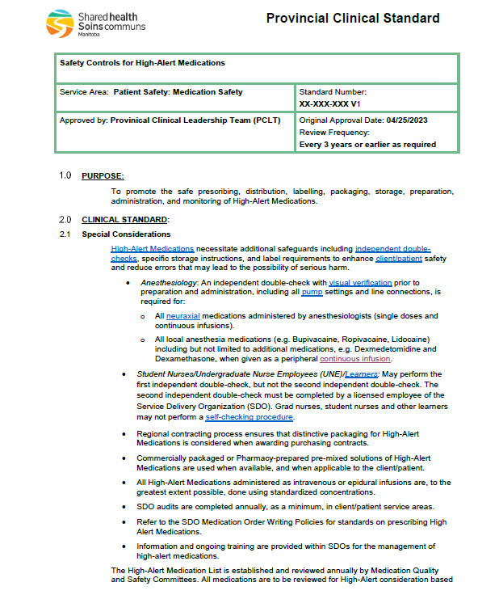
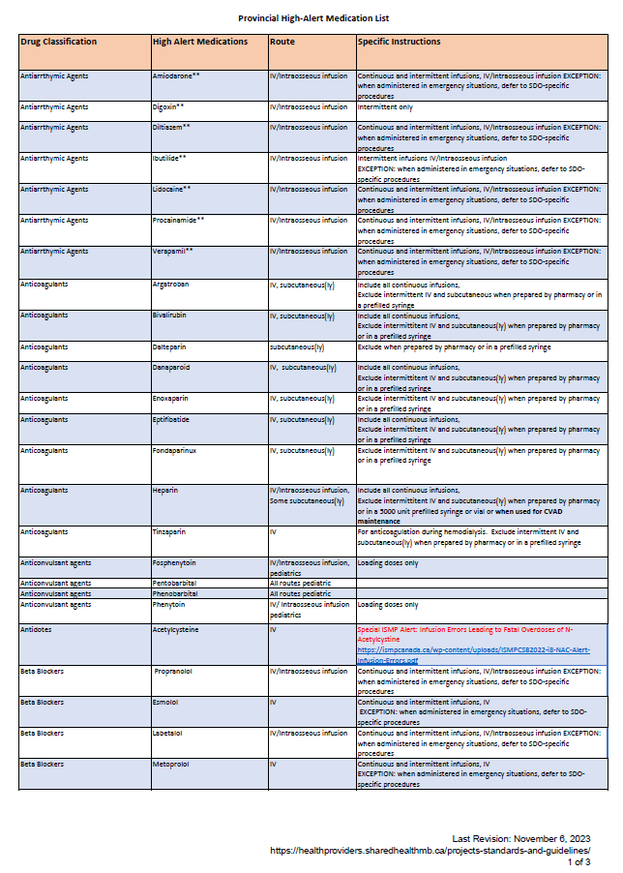
High-Alert Medication Clinical Practice Documents
The new provincial clinical standard for High-Alert Medications consists of 2 documents:
1 – Safety Controls for High-Alert
Medication, Provincial Clinical
Standard
2 – Provincial High-Alert Medications List
* notes
+
Clinical Standard
HAM List
Notes:
The High-Alert Medication List organizes medications by drug classification, e.g. anticoagulant. It identifies which medication routes are ‘high-alert’ and special instructions or considerations
There are several HAM lists developed for reference, differing in appearance but consistent in content. The High-Alert Medications on the HAM list and Provincial Clinical Standard (found on the Shared Health – Health Providers webpage) shall be the primary and most accurate reference document.
HAM = High-Alert Medications

Slide 5
Key Definitions
High-Alert Medications (HAM)
Medications that pose a higher risk of causing significant or devastating patient, client, resident harm if a medication error occurs.
Independent Double-Checks
A second Health Care Practitioner checks all drug calculations, preparation, and administration separately and independently from the first practitioner. Visual verification (looking/inspecting) is used during the process.
Self-Checking with Time-Out Procedure
A procedure used when working alone to double-check medication preparation and administration.
The definitions above are abbreviated. Refer to the Provincial HAM clinical standard for the full definition.
Notes:
The definitions above are abbreviated and originally obtained from the Provincial High Alert Medication Clinical Standard
The standard outlines which steps within the preparation and administration process need to be visually verified by a second health care professional in a separate and independent manner.

Slide 6
Finding the Provincial Clinical Standard & List
The provincial clinical standard and list are found online:
Shared Health – Health Providers webpage in the Provincial Clinical Project, Standards, and Guidelines section
This is the Shared Health webpage for all provincial clinical standards, guidelines, supporting documents and implementation resources.
We recommend always accessing clinical documents electronically to ensure that you read the most up-to-date version.
SDOs and Facilities – if applicable, identify the location(s) of links to the Provincial Standard and List
Notes:
the Projects, Standards & Guidelines - Shared Health - Health Providers (sharedhealthmb.ca) page is the “true source” of the HAM Standard, List, resources, etc that should be linked to.
Each region will determine how to do that linking and operationalize the resources based on local processes/flows.

Slide 7
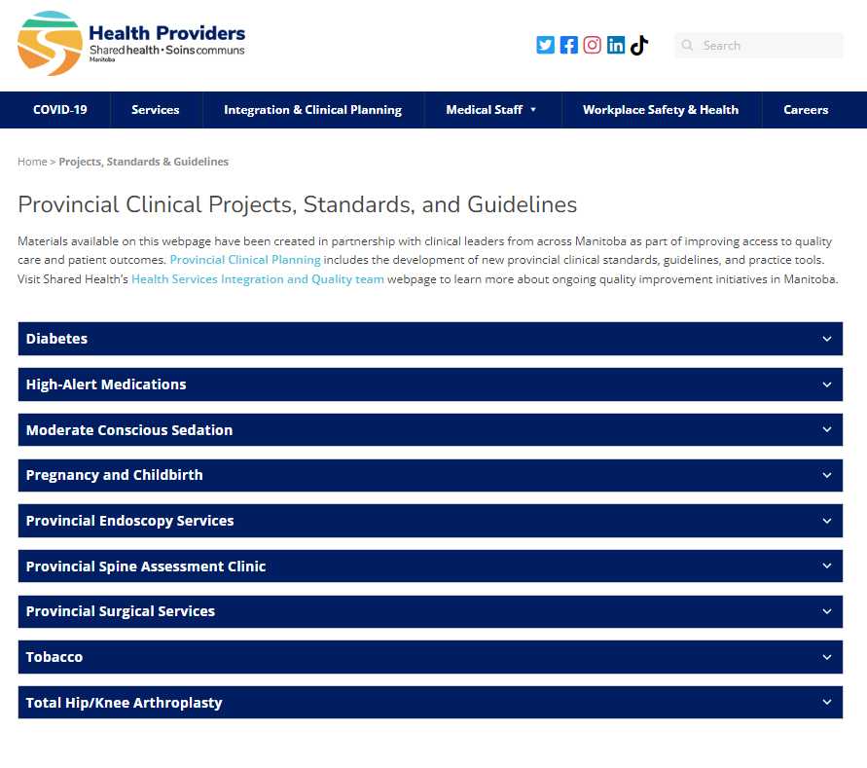
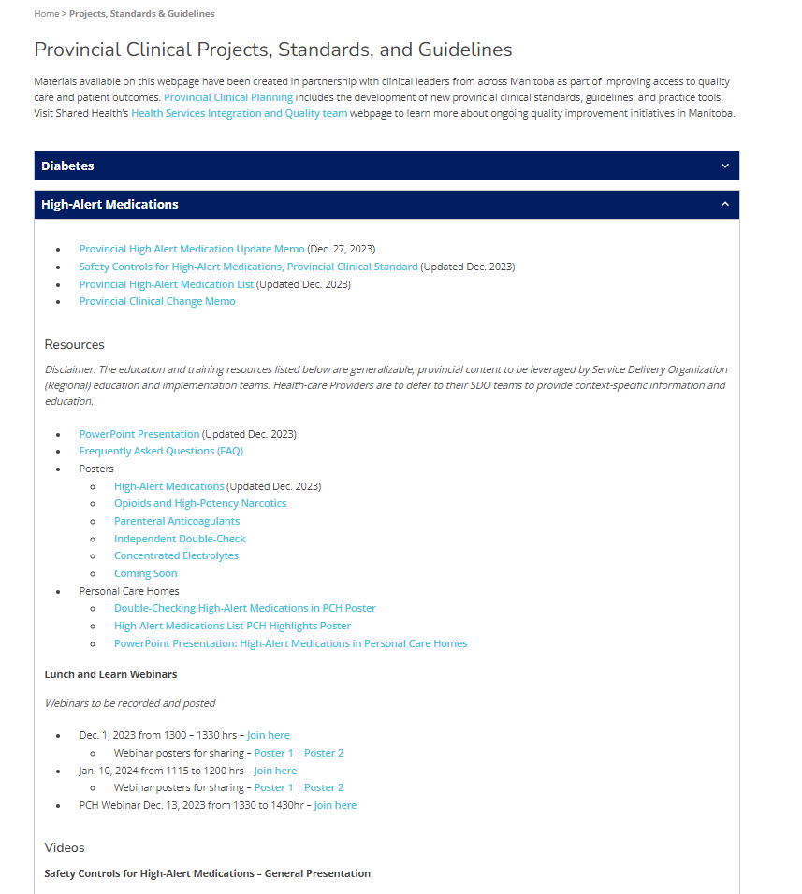
Notes:
The link in all the documents will take you straight to the High Alert Medication resource page or deeper if you choose (directly to the memo, Standard, or the Medication List itself. Depending on which link you want to go to. Each SDO has had these links shared so that they can determine how best to link to this source for their own supporting policy, or communication from their home website.
The links that have been used are permanent links , meaning they will remain intact.

Slide 8
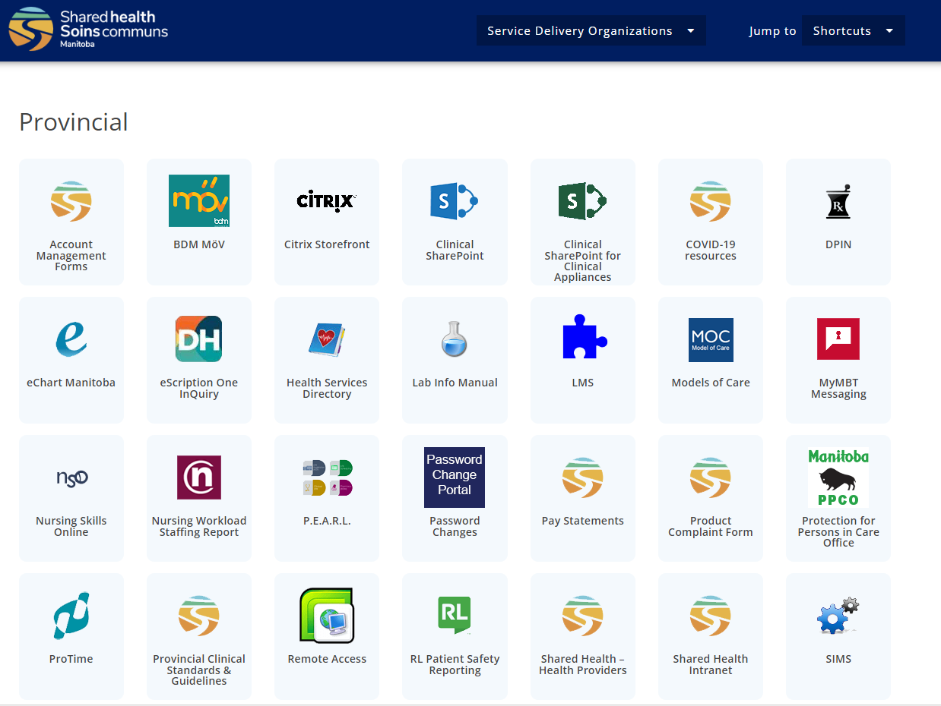
Notes:
Some have asked where the Provincial Clinical Standard and Guidelines page actually “lives” or how it can be located if you didn’t have the direct link. See above image. All the current and new Guidelines and Standards being developed will be housed here for linking as required.

Slide 9
Changes from SDO/Facility/Program Practice
Use this slide to help identify changes that clinicians can expect due to the introduction of the provincial clinical standard and list.

Slide 10
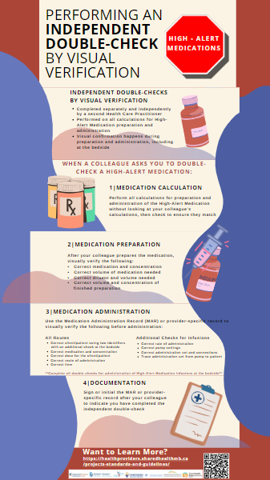
Independent Double-Checks
Independent double-checks by visual verification of HAMs enhance safety by helping identify errors that may lead to serious harm.
Independent double-checks are performed by a second Health Care Practitioner in a separate and independent manner from the first:
During HAM preparation in a patient/client/resident area,
Before HAM administration using the MAR or order and
At the bedside when starting a HAM infusion when rate, dose, infusion container change and care transitions.
Emergencies are exceptional circumstances, where an independent double-check with visual verification may not be possible. Certain High-Alert Medications are exempt from independent double-checks in emergency situations; however, Health Care Practitioners are then to defer to SDO-specific policies or procedures for guidance.
Emergency situation exceptions are found on the HAM List. Example:
Notes:
IV/ Intraosseous Infusion Emergent Situation Time Out Medication examples:
Amiodarone
Diltiazem
Propranolol
HAMs = High-Alert Medications
SDO policies, such as Code Blue, may define what constitutes an emergency, if double-checks are required or how to perform a HAM double-check in emergency situations e.g. recommending that Health Care Practitioners defer to a self-checking timeout procedure where reasonable.

Slide 11
Independent Double Checks
The Clinical Standard outlines role-specific independent double-checks by visual verification considerations:
Anesthesiology
An independent double-check with visual verification prior to preparation and administration, including all pump settings and line connections, is required for:
All neuraxial medications administered by Anesthesiologists (single doses and continuous infusions).
All local anesthesia medications (e.g. Bupivacaine, Ropivacaine, Lidocaine), including but not limited to additional medications, e.g. Dexmedetomidine and Dexamethasone, when given as a peripheral continuous infusion.
All other HAMs are exempt.
Student Nurses/Undergraduate Nurse Employees (UNE)/Learner
The clinical standards’ statement on Student Nurses and UNEs is inclusive of all learners, which includes student Paramedics, student Respiratory Therapists, Student Nurses (LPN, RN, RPN) and Internationally Educated UNEs.
Learners may NOT perform the first or second independent double-check
The independent double-checks must be completed by two licensed (e.g. GN, RN, LPN, RPN) health care professionals.
Grad Nurses, nursing students and other learners may not perform a self-checking procedure.
Notes:
Student Nurses/Undergraduate Nurse Employees (UNE)
UNEs are employees of SDOs but not yet licensed and, therefore, still categorized as a learner for the purposes of the HAM clinical standard.
Supervised Internationally Educated Nurses fall into the category of learners.
‘Learner’ is inclusive of student Paramedics, student Respiratory Therapists, Student Nurses (LPN, RN, RPN) and Graduate Nurses.
Graduate Nurse is inclusive of GPNs, GPsyNs and GN (RNs)

Slide 12
Medication Preparation – Independent Double-Checks
An independent double check of all calculations is performed when a High-Alert Medication is prepared in a patient/client/resident care area. The EXCEPTION is when preparing medications according to standardized instructions for preparation detailed in SDO Parenteral Drug Monographs or Pharmacy Batch Compounding Records.
During the preparation of a High-Alert Medication in a client/patient care area, the following independent double-checks by visual verification need to be performed:
• The correct medication and concentration
• The correct volume of medication needed
• The correct diluent and volume needed
• The correct volume and concentration of finished preparation
Infusions: Labelling
The initials of two Health Care Practitioners who prepared the medication and performed the independent double check of calculations are written on the preparation label of High-Alert Medication infusions. If the Health Care Practitioner works alone, the Self-Checking with Timeout Procedure is followed.
Medication preparation initials are not required for Pharmacy-prepared or commercially-prepared infusions.
Notes:
Medication labelling recommendations are listed in 2.2.2.2 of the Clinical Practice Standard
‘Recommendation’ wording is utilized because Provincial Shared Health or SDOs do not possess the authority to define manufacturer or commercial pharmacy labels.
The initials of calculation and medication preparation are not optional for SDO Health Care Professionals.

Slide 13
Medication Administration – Independent Double-Checks
An independent double-check by visual verification using either a Medication Administration Record (MAR), Discipline or provider-specific record or Provider order as per program procedure of the following information is performed BEFORE administering a High-Alert Medication.
• Correct client/patient using two identifiers
IM/Subcutaneous/Direct IV/Oral: An independent double-check against the MAR discipline or provider-specific record; followed by a check at the bedside by one of the health care practitioners against the MAR and armband. See notes
Infusions: The independent double-check occurs at the bedside.
• Correct medication and concentration
• Correct dose for the client/patient
• Correct route of administration
• Correct time
Notes:
Other High-Alert Medication administration routes that require an independent double-check against the MAR or provider-specific record or provider order includes:
Sublingual
Intranasal
Dermal Patch

Slide 14
Medication Administration - Independent Double-Checks
Intermittent and continuous infusions of High-Alert Medications require additional independent double-checks by visual verification:
Rate
Pump settings
Correct administration set and/or connectors
Trace administration set from the infusion container through the pump to the patient/client
Perform independent double-checks when establishing an infusion, changing rate/dose, changing the infusion container or when a transfer of care occurs.
EXCEPTION: when titrating continuous infusions as per prescribers’ orders vasopressors, midazolam, and propofol in Adult ICUs, PACUs, Emergency/Urgent Care Departments and with Adult Critical Care Transport Teams. See the High-Alert Medication List with double asterisks(**) for specific medications.
Pediatric high-acuity environments will continue to perform their independent double-checks when titrating HAM.
When performing a HAM administration independent double-check by visual verification, one of the two Health Care Practitioners must have been involved in its preparation (double-check) unless it was pharmacy-prepared.
Notes:
The person who performed the independent double-check of the medication administration signs or initials on the MAR or provider-specific flowsheet

Slide 15
Medication Administration - Documentation
The first initials on a MAR or provider-specific record is that of the Health Care Practitioner who administered the HAM. The second, are those of the person providing the independent double-check by visual verification. See notes
When initialing for HAM administration, one of the two Health Care Practitioners must have been involved in its preparation (double-check) unless it was pharmacy-prepared.
Electronic Medication Records: Utilize the co-signing field to document the name of the second independent double-check practitioner.
Notes:
Note: When initials are used in place of a signature, they must identify the employee and their designation and be recognizable in the chart.

Slide 16
Self-Checking with Time-Out Procedure
When working alone, the Self-Check with a Time-Out Procedure is performed.
The same double-checks are performed as one would with an independent double-check when preparing and administering High-Alert Medications.
An unrelated task should be done between doing the initial calculation, medication preparation and self-checking. This process, known as a time-out, offers a final verification process from a fresh perspective.
Self-checking with a time-out procedure is not an alternative to independent double-checks by visual verification.
Documentation
The Health Care Practitioner performing the Self-Checking with Time-Out Procedure initials the label, MAR, discipline, or provider-specific record, e.g. flowsheet or Pharmacy preparation record, twice as an indication that this procedure was performed.

Slide 17
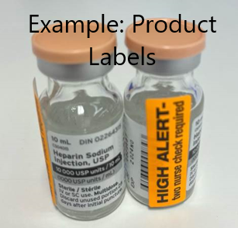
Storage and Flagging of High-Alert Medications
High-Alert Medications within the clinical environment require flagging to alert Health Care Practitioners of their potential for harm and to align with the Provincial High-Alert Medication list.
System Flags Include:
Parenteral Drug Monographs - All monographs for High-Alert Medications are currently identified with a “HIGH ALERT MEDICATION” banner.
Premixed Epidural Solutions - Clearly labelled "For Epidural Infusion Only“
Intrathecal Medications - Clearly labelled “For Intrathecal Use Only”
Ward Stock in Client/Patient Care Areas
Limiting HAM ward stock to those essential in providing timely care
Shelf/bin or product labelling (also applicable to Pharmacy storage)
Intrathecal and epidural medications are stored separately from intravenous preparations

Slide 18
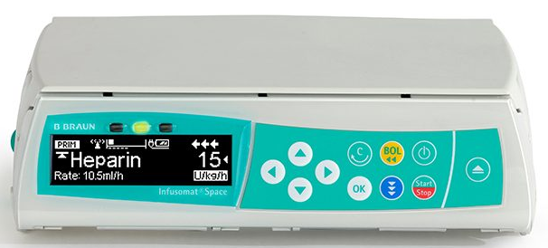
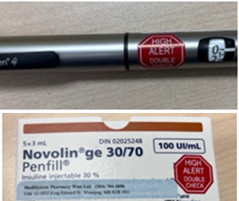
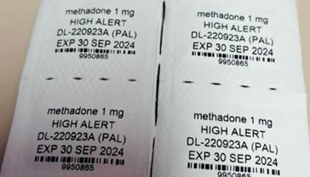
Storage and Flagging of High-Alert Medications
System Flags Include (continued):
IV Infusion Pumps
Drug Error Reduction Software flag where available
Client/Patient-Specific Dispensed
Medications dispensed directly from the Pharmacy have an auxiliary label on the product or client/patient-specific label. Medications dispensed for patient self-administration at home do not require an auxiliary label
Auxiliary Label Examples
Automated Dispensing Units (e.g. Pyxis) – Clinical alert
Electronic Medication Record - High-Alert Medication flag as supported by software (not flagged as of Nov 2023)
Notes:
IV Infusion Pump image obtained from https://www.bbraun.ca/en/products/b/2nd-generation-spaceinfusomatlargevolumepump.html

Slide 19
Knowledge Check
Where can you find an online link to the Safety Controls for High-Alert Medication Provincial Clinical Standard and the Provincial High-Alert Medications List?
What procedure should be used when a High-Alert Medication requires administration and the Health Care Practitioner works alone?
Which medication classification requires an independent double-check with visual verification before preparation and administration by Anesthesiology?
Where should the independent double-check by visual verification be performed BEFORE administering a High-Alert Medication infusion? Assume the calculation and preparation checks have already been performed.
What is the HAM Clinical Standard and List guidance for emergency situations with certain High-Alert Medications?
*Answers found in PowerPoint notes
Notes:
Answers
The provincial clinical standard and list are found in two locations online. The first is on the Shared Health – Health Providers webpage in the Provincial Clinical Project, Standards, and Guidelines section and the second it the WRHA Evidenced Informed Practice Tools (EIPT) database. (PPT slide 5)
When working alone, the Self-Check with a Time-Out Procedure is performed. The same double-checks are performed as one would with an independent double-check when preparing and administering High-Alert Medications. An unrelated task should be done between doing the initial calculation, medication preparation and self-checking. This process, known as a time-out, offers a final verification process from a fresh perspective. (Slide 13 or 2.2.4 within the Clinical Standard)
All neuraxial medications administered by Anesthesiologists (single doses and continuous infusions).
All local anesthesia medications (e.g. Bupivacaine, Ropivacaine, Lidocaine), including but not limited to additional medications, e.g.
Dexmedetomidine and Dexamethasone, when given as a peripheral continuous infusion. (Slide 8 or 2.1 within the Clinical Standard)
4. HAM infusions require an independent double-check at the bedside. (Slide 10 or 2.2.3.1 within the Clinical Standard)
Several HAMs identified in the HAM List are an exception to independent double-checks during emergency situations. Health Care Practitioners are to defer to SDO-specific policies and procedures when preparing and administering these HAM medications in emergency situations e.g. Code Blue.
SDO policies, such as Code Blue, may define what constitutes an emergency, if double-checks are required or how to perform a HAM double-check in emergency situations e.g. recommending that Health Care Practitioners defer to a self-checking timeout procedure where reasonable.

